Slide 1

watsonx Orchestrate
Seller Enablement
Jack Schaefer
WW Technology Enablement
jschaefer@ibm.com
Peter Keller
Product Lead, watsonx Orchestrate GTM
Peter.keller@ibm.com
Vlad Stojanovski WW Technology Enablement vstojano@us.ibm.com
Notes:
This presentation is designed to equip sellers with the knowledge and messaging needed to effectively position and sell watsonx Orchestrate. It serves as a follow-up to the client-facing deck, which should be reviewed first.
Consider the client presentation as Part 1, providing a concise and high-level introduction. This enablement deck is Part 2, providing deeper guidance, examples, and positioning strategies to assist sellers in driving engagement and opportunity development. Since client meetings are often time-constrained, sellers are encouraged to customize their presentations, using slides from this deck to enhance or extend the client deck as needed for the conversation.
Links:
Client Presentation: https://ibm.seismic.com/Link/Content/DCqd9cB4HbG6jGmH4VjTgjQWpfP8.
The watsonX Orchestrate Sales Kit on Seismic has additional product assets: https://ibm.seismic.com/Link/Content/DCbHf2RCFTPf3G9Cc2PBGggJWfGV.
Note to seller:
“Client Zero” is a term used in this presentation to refer to IBM’s own deployment of watsonx technologies to transform its business operations. IBM’s Client Zero business results are available in Seismic, and sellers can share these incredible transformation stories with their clients. This includes domain transformation journeys and dozens of use cases that will resonate with clients. Terms in this presentation, including AskHR, AskIT, AskProcurement, AskSales, CA@IBM (Code Assistant at IBM) and WCA@RedHat (watsonx Code Assistant at Red Hat) refer to AI assistants and agent solutions that are part of this transformational journey. More information is available at: https://ibm.seismic.com/Link/Content/DC3FBFRjP8VpR8QPRHF9Xh7VfDdj.

Slide 2
Seller guidance and legal disclaimer
Slides in this presentation marked as "IBM and Business Partner Internal Use Only" are for IBM and Business Partner use and should not be shared with clients or anyone else outside of IBM or the Business Partners’ company.
© IBM Corporation 2025. All Rights Reserved.
The information contained in this publication is provided for informational purposes only. While efforts were made to verify the completeness and accuracy of the information contained in this publication, it is provided AS IS without warranty of any kind, express or implied. In addition, this information is based on IBM’s current product plans and strategy, which are subject to change by IBM without notice. IBM shall not be responsible for any damages arising out of the use of, or otherwise related to, this publication or any other materials. Nothing contained in this publication is intended to, nor shall have the effect of, creating any warranties or representations from IBM or its suppliers or licensors, or altering the terms and conditions of the applicable license agreement governing the use of IBM software, IBM hardware, or IBM services.
References in this presentation to IBM products, programs, or services do not imply that they will be available in all countries in which IBM operates. Product release dates and/or capabilities referenced in this presentation may change at any time at IBM’s sole discretion based on market opportunities or other factors and are not intended to be a commitment to future product or feature availability in any way. Nothing contained in these materials is intended to, nor shall have the effect of, stating or implying that any activities undertaken by you will result in any specific sales, revenue growth, or other results.
All client examples described are presented as illustrations of how those clients have used IBM products and the results they may have achieved. Actual environmental costs and performance characteristics may vary by client.
IBM and Business Partner Internal Use Only
Notes:
This self-explanatory slide shares seller guidance and legal disclaimers for this presentation.

Slide 3

Agenda:
The market opportunity
Use cases
Product capabilities
Agent orchestration
Agent catalog
Agent building tools
AgentOps
Case studies & references
Prospecting & progressing guidance
Competitive differentiation
Pricing & packaging basics
Seller Resources
Notes:
The following topics will be covered in this presentation.

Slide 4
A fundamental shift is underway for AI
AI that can generate for you
AI that can chat for you
AI that can do for you
Models
​Next-token prediction
Text generation
Pattern matching
Assistants Powered by single customized LLM & large training data
Inflexible & brittle at run-time
Agents Powered by the think- act-observe loop
Flexible & adapts to real-time data
Feed-forward systems
Feedback systems
Input prompt
Input: complex task
LLM
Think and plan
Output
Act
Observe
Output
Notes:
The evolution of generative AI has rapidly progressed from content generation to autonomous task execution. Earlier advances introduced large language models (LLMs) , which are capable of generating human-like text, images, audio, and video, fundamentally shifting how content was produced. Soon after, generative models were embedded into conversational assistants, enabling sustained dialogue and the ability to analyze documents and respond contextually. These assistants, typically powered by single LLMs, marked a significant step forward but remained limited to single-step interactions.
Since late 2022, AI assistants have started to mature into enterprise tools capable of integrating with systems, retrieving information, and completing prescriptive tasks. Now, agentic AI signals the next evolution: intelligent agents that can plan, reason, and autonomously execute complex, multi-step workflows. These agents interact with digital environments, collect data, and make decisions—all while maintaining enterprise-grade standards for safety, governance, and control.
Unlike early rules-based chatbots or static machine learning (ML) systems, modern AI agents operate within dynamic feedback loops. Through a “think-act-observe” process, they can invoke tools, evaluate outcomes, and iterate toward optimal results. This chain-of-thought reasoning enables continuous improvement, task sequencing, and coordination across multiple agents.
The ecosystem supporting AI agents is also advancing. IBM now provides enterprises access to no-code, low-code, and pro-code development options, as well as prebuilt domain-specific solutions that accelerate deployment and shorten time-to-value. These capabilities empower clients to leverage AI agents not just as technology, but as a strategic asset, driving innovation, operational efficiency, and competitive differentiation across industries.
This presentation highlights how watsonx Orchestrate has been reimagined to help clients accelerate and scale AI adoption in an agentic world, moving away from heavy reliance on large training datasets, rigid workflows, and high ownership costs. With agents, organizations gain greater flexibility by combining knowledge, tools, and tool flows to support dynamic, efficient interactions and faster time-to-value. Instead of training assistants tied to fixed skill flows, the focus shifts to building intelligent agents that are equipped to operate across applications, data, and AI, adapting in real-time to deliver optimal outcomes.

Slide 5


Open, hybrid – any AI model, any agent framework
Integrating AI agents with existing AI & automation investments ushers a new opportunity to unlock enterprise productivity:
By 2028, one-third of interactions with generative AI services will use action models and autonomous agents for task completion¹, creating a $47.1 billion white space for enterprise productivity.²
A single platform that orchestrates work across Agents, data, business processes & applications, unlocking new ways to do work
AI agents
watsonx
Conversational solutions
Intelligent process automation
Unified platform for Assistants & Agents
Deep enterprise integration
Notes:
Early investments in generative AI have laid a strong foundation, but the next frontier is scale; specifically, embedding AI into core workflows across business functions to unlock greater enterprise value. This is where AI agents, conversational interfaces, and intelligent process automation converge to enable digital labor at scale.
Market trends show a clear convergence: once-siloed technologies like Robotic Process Automation (RPA), Conversational AI, and Integration Platforms as a Service (iPaaS) are rapidly integrating. RPA vendors are expanding into Intelligent Document Processing (IDP), process mining, and digital assistants. Meanwhile, Conversational AI platforms are incorporating APIs, RPA connectors, and document ingestion—transforming from point solutions into broader automation platforms.
At the center of this convergence is IBM watsonx Orchestrate, a platform purpose-built to unify these evolving capabilities. It brings together AI agents, conversational experiences, and automation into a single system, enabling businesses to streamline tasks, scale productivity, and reduce operational complexity. For example, an HR department can automate onboarding by combining prebuilt agents, natural language interfaces, and system integrations—all orchestrated within one platform.
Unlike traditional automation that depends on rigid workflows and extensive rule writing, AI agents, powered by large language models (LLMs), are adaptive, context-aware … and continuously improving. They reduce development overhead, integrate easily with enterprise systems, and accelerate time-to-value. A customer care agent, for instance, can access knowledge bases, invoke backend APIs, and escalate to humans—all within a single chat interface.
The strategic implications are substantial. Gartner predicts that by 2028, one-third of generative AI interactions will involve autonomous agents capable of completing tasks end-to-end. This shift reflects growing pressure on IT and business leaders to move beyond AI experimentation and deliver measurable results.
Organizations that embrace AI agents today are positioned not just to improve operational efficiency but also to unlock new revenue streams and competitive advantage. With watsonx Orchestrate, enterprises can scale automation, connect with existing investments like Salesforce or Workday, and deploy AI agents that deliver faster, higher-quality outcomes—laying the groundwork for a future-proof digital strategy in an AI-driven world.
Sources:
¹ “Gartner Predicts One-Third of Interactions with GenAI Services Will Use Action Models & Autonomous Agents”, Gartner, March 2024: https://www.gartner.com/en/newsroom/press-releases/2024-03-11-gartner-predicts-one-third-of-interactions-with-genai-services-will-use-action-models-and-autonomous-agents-for-task-completion-by-2028
² “AI Agents Market by Agent Role – Global Forecast to 2030, Markets and Markets”, January 2025: https://www.prnewswire.com/news-releases/ai-agents-market-worth-47-1-billion-by-2030---exclusive-report-by-marketsandmarkets-302246356.html

Slide 6






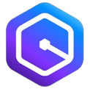


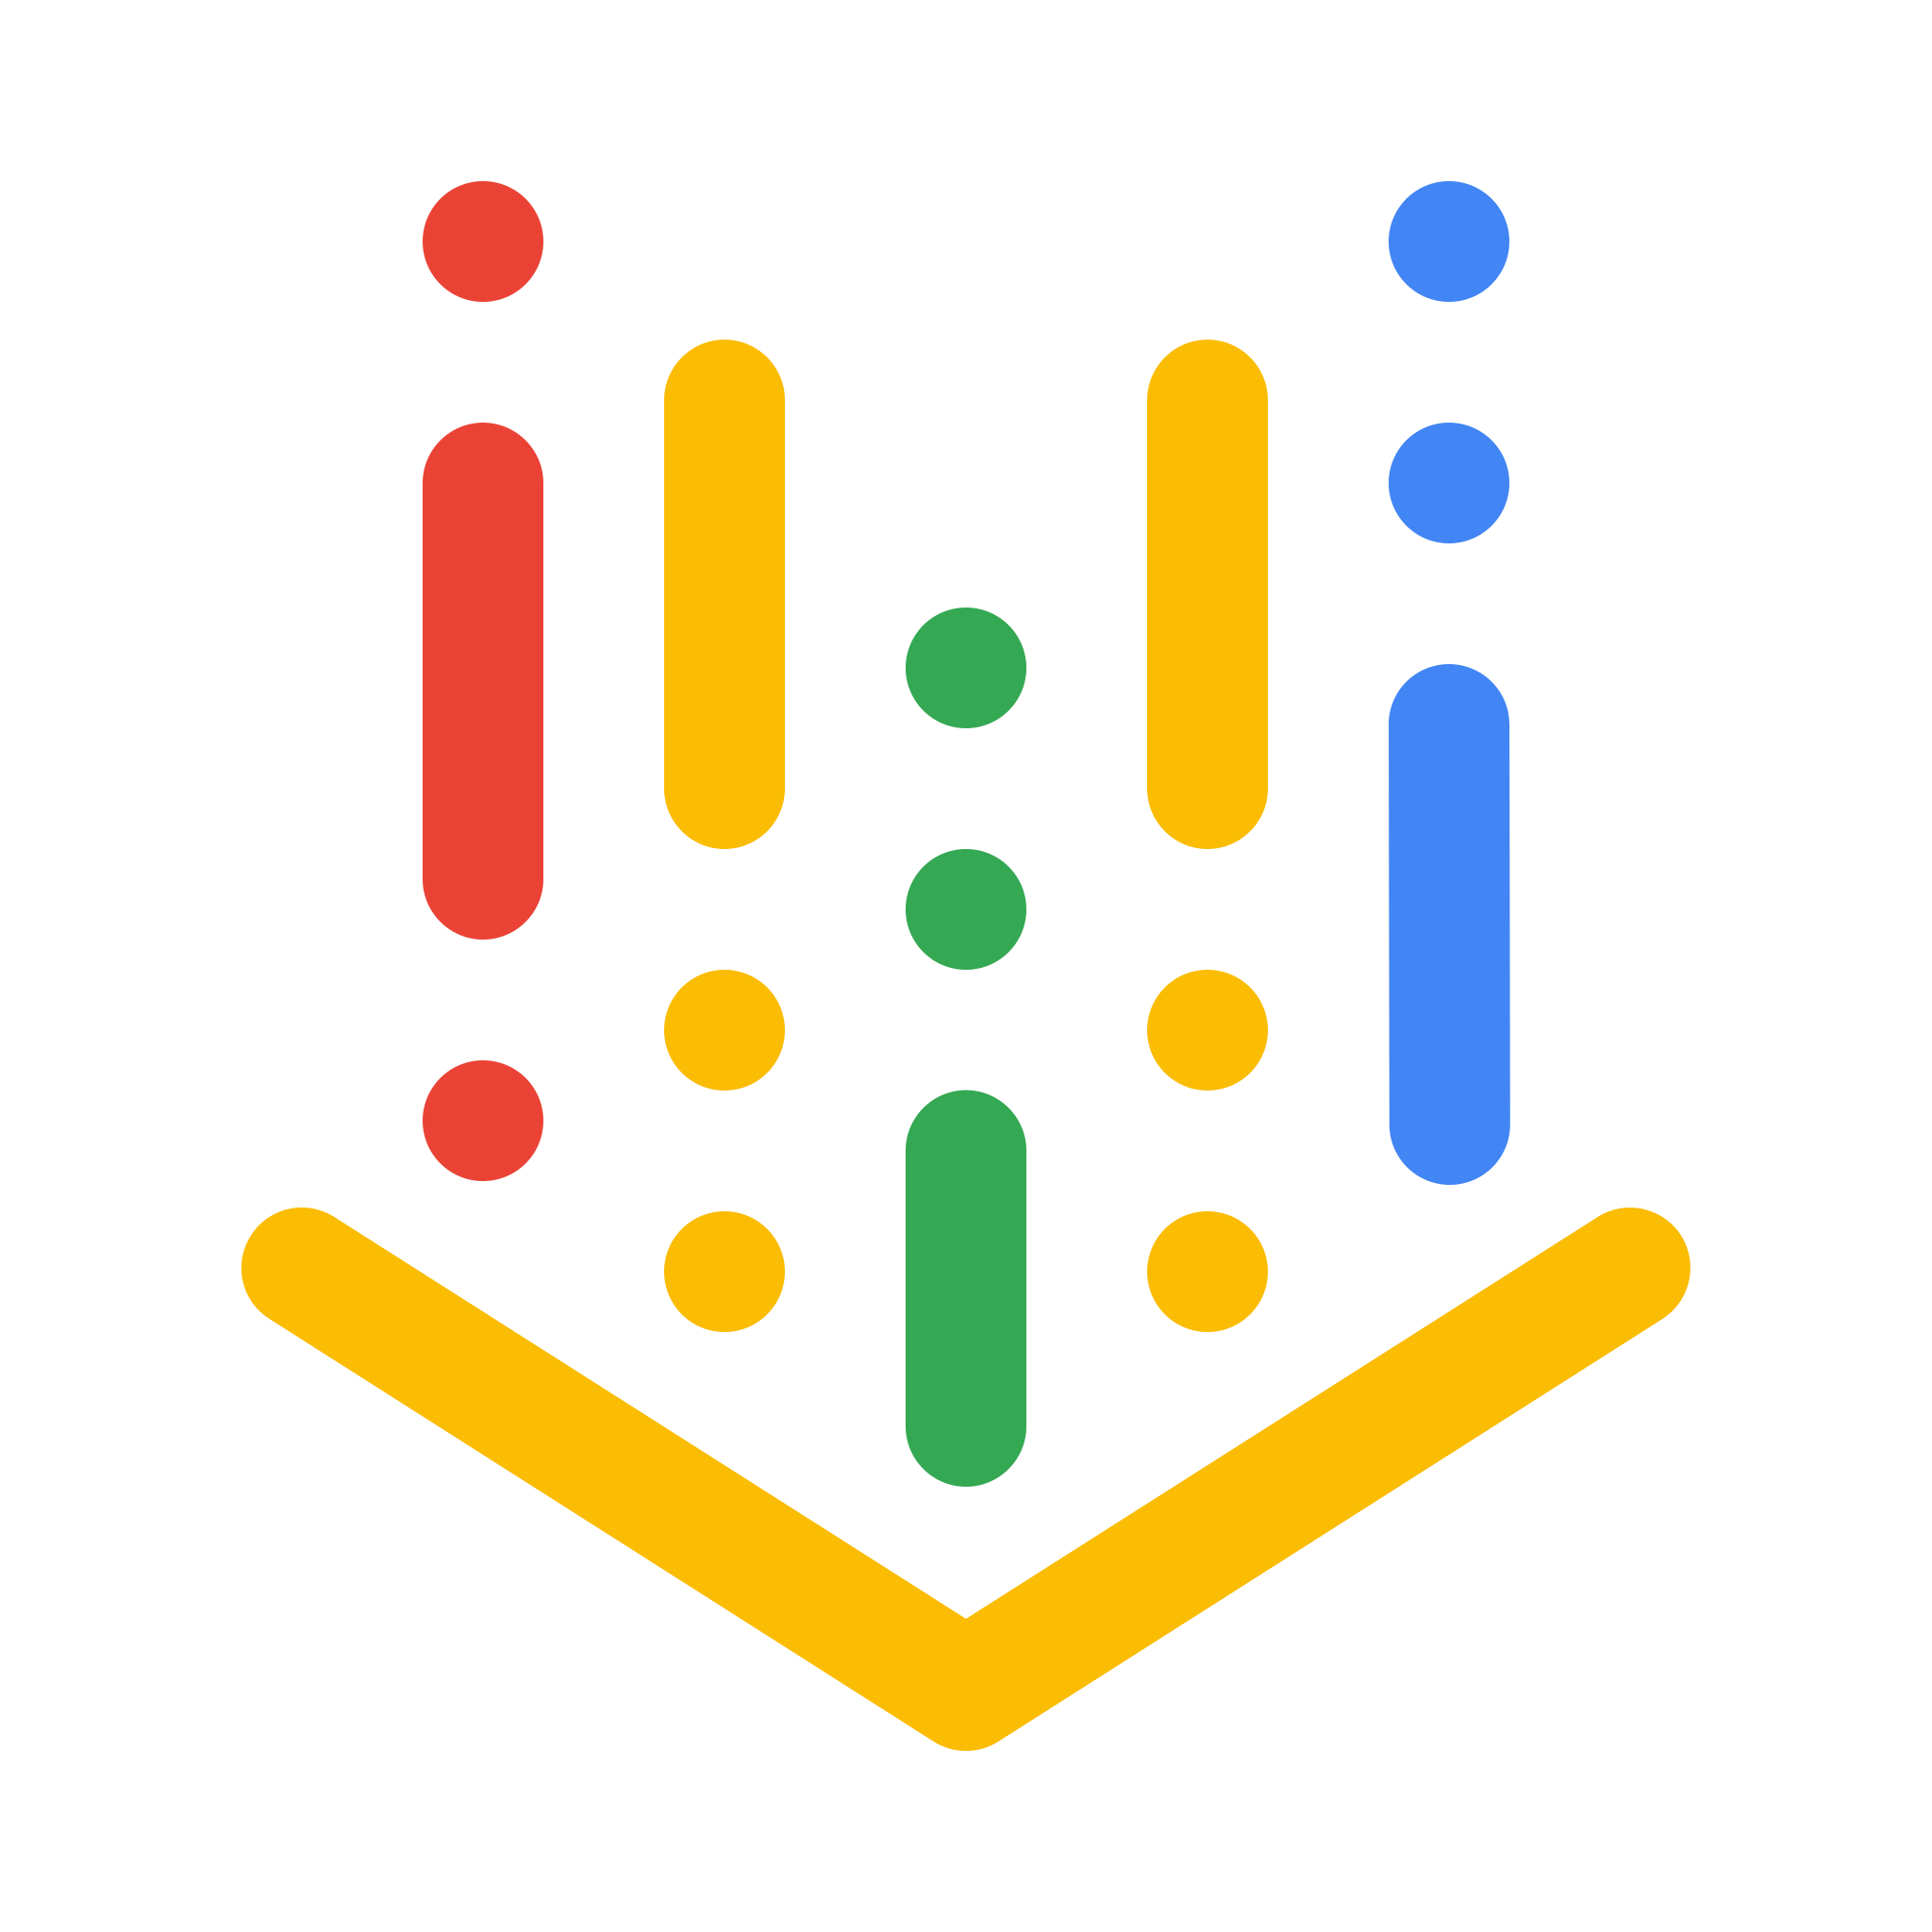




The hype: Building agents is easy
Reality: Doing it at scale is not
75%
Apps
of executives rank AI as a top-three priority¹
25%
AI Frameworks and Vendors
Amazon Q
but only are realizing ROI from their AI¹
Vertex AI
CoPilot
M365
Notes:
AI has become a strategic priority, with 75% of executives ranking it among their top three investment areas. It’s already embedded across business functions—from HR and finance to IT and customer service—but many enterprises are struggling to realize its full potential. In fact, only 25% report achieving a significant return on investment.
This shortfall stems from fragmentation. AI is often deployed in silos—disconnected tools, function-specific agents, and one-off automations that address individual pain points but fail to drive enterprise-wide transformation. For instance, one team might use a chatbot for benefits questions while another builds a separate workflow automation for supplier onboarding, with no shared knowledge, tools, or governance between them.
The shift toward AI agents offers a path forward but also introduces new complexity. Enterprises are now envisioning ecosystems where hundreds or even thousands of agents operate across the organization, developed using different platforms and frameworks, sourced from vendors or internal teams. To deliver real value, these agents must be deeply integrated with enterprise systems, interoperable across domains, and accessible through a unified experience—whether embedded in applications or through natural language interfaces.
Yet, most AI agents today lack this level of integration. They struggle to access enterprise data, connect to existing automations, or comply with IT standards, which slows time-to-value and limits scalability. For example, a customer care agent may answer basic inquiries but falls short when it needs to initiate a return, escalate an issue, or retrieve order status from a backend system.
At scale, this fragmentation becomes an operational burden. Managing agents across teams, ensuring they’re secure, reliable, and performing as expected requires enterprise-grade orchestration, observability, and governance.
To move beyond experimentation, AI must be treated as a first-class enterprise capability. That means deploying agents that are secure, trusted, and governed, just like any other mission-critical system. Only with this foundation can enterprises fully harness AI to improve outcomes, reduce costs, and gain competitive advantage at scale.
Source:
¹ “Why 75% of businesses aren’t seeing ROI from AI yet”, Forbes, January 2025: https://www.forbes.com/sites/cio/2025/01/30/why-75-of-businesses-arent-seeing-roi-from-ai-yet/

Slide 7
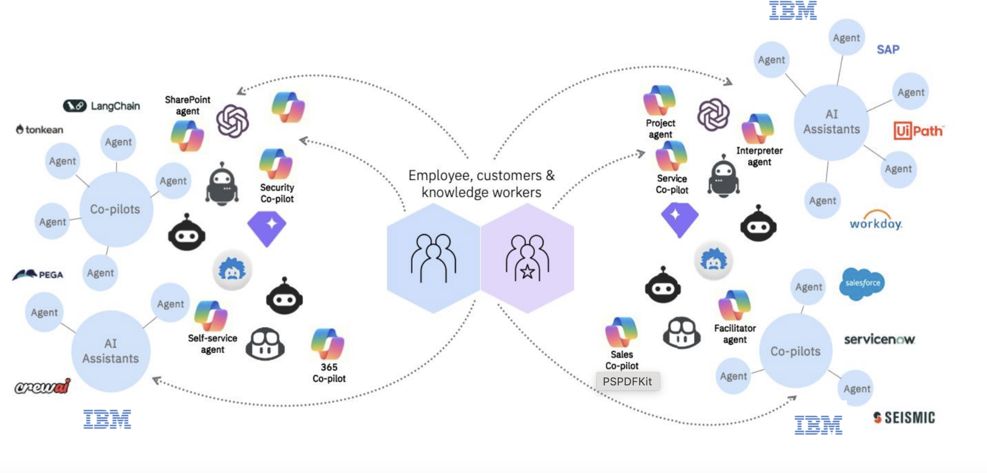
Breaking the productivity ceiling with AI agents
How can enterprises securely access, monitor, and coordinate agents—at scale?
Security
Observability
Governance
Agent ecosystem management
Role-based access
SSO integration
Connection management
Telemetry (Langfuse, OTEL)
Performance dashboards
Action traceability
Evaluation, auditability, and compliance
Pre-built agents
3rd party agents
Custom agents
Watch the 2025 THINK Keynote →
Notes:
As enterprises advance their AI maturity, they are progressing from foundational large language models (LLMs) to intelligent AI agents capable of real business impact. These agents mark a critical evolution, combining conversational AI with process automation to create a more adaptive, responsive digital workforce.
However, despite this progress, a new set of challenges has emerged. Many organizations now face fragmentation across their AI landscape—tools, assistants, and agents scattered across business units, platforms, and vendors. For example, a marketing team may deploy a third-party content assistant, while the IT department manages a separate helpdesk bot and HR maintains a proprietary onboarding agent. These disconnected implementations often lack shared governance, consistent orchestration, or the ability to scale in unison.
To fully capitalize on the agentic future, enterprises need a unified and secure ecosystem—a Trusted Agentic Framework. This framework must ensure that agents and assistants are governed, observable, and accessible in a coordinated environment, with the same rigor applied to any enterprise IT system.
To deliver on this vision, agentic platforms must offer:
Enterprise-grade access and security, including role-based access control (RBAC), single sign-on (SSO), and encrypted credential management; for example, ensuring an AI finance agent cannot access HR data without appropriate permissions.
Visibility and monitoring (observability), including centralized telemetry using tools like Langfuse or OpenTelemetry (OTEL), providing performance dashboards, behavior logs, and usage analytics to track agent reliability and improvement over time.
Governance and auditability, including traceable action histories to support compliance, accountability, and explainability—especially critical in regulated industries like healthcare or finance.
Evaluation frameworks, including consistent mechanisms to benchmark agent performance, validate outputs, and assess alignment with business rules and ethical standards.
Today, enterprises often juggle multiple types of agents: prebuilt agents like an IBM HR Employee Support agent, third-party tools integrated for functions like IT service management, or custom-developed agents supporting industry-specific workflows. Without a coordinated approach, managing this diversity becomes complex and inefficient.
Business and technical leaders need the ability to:
Easily discover and deploy agents
Monitor and compare agent performance
Navigate seamlessly between agents in a shared environment
Enforce responsible AI agent behavior aligned with policy and business outcomes
IBM’s approach, delivered through watsonx Orchestrate and the broader watsonx platform, addresses these challenges head-on. It provides the tools and architecture to orchestrate AI agents across teams and systems within a trusted, governed environment—turning today’s scattered solutions into tomorrow’s enterprise-grade digital labor strategy.
At THINK 2025, IBM unveiled the most comprehensive set of agent capabilities in the industry to help companies build, run and manage agents in a dedicated keynote. This keynote is available at: https://www.ibm.com/think/videos/think-keynotes/ai-agents-enterprise.

Slide 8

Agentic AI buyer trends: From exploration to impact
71%
49%
9 out of 10 senior decision-makers are shifting their Gen AI investments to projects that will improve business performance.¹
71% of gen AI spending will go to HR, finance, customer service, sales & marketing, where investments are expected to drive quick ROI.²
of AI development cost is labor. Each AI model comes with its own set of labor costs, so buyers are leaning towards embedded generative AI capabilities.³
Notes:
As the adoption of generative and agentic AI accelerates, buyer expectations are shifting dramatically. In 2025 and beyond, enterprise decision-makers are moving beyond experimentation and prioritizing solutions that deliver measurable business outcomes.
Over the past two years, companies have invested heavily in AI exploration—many prototyping 25 to 30 use cases across departments. But the era of broad, trial-and-error development is giving way to a more focused approach. Today’s buyers are laser-focused on rapid time-to-value and high return on investment (ROI). In fact, nine out of ten decision-makers are now reallocating AI budgets toward projects directly tied to business performance and productivity gains.
IBM engagements consistently reveal the same enterprise priorities: Human Resources, Finance, Customer Care, Sales, and Marketing. These remain the most in-demand domains for automation and AI-driven transformation. What clients seek now are pre-validated, production-ready use cases that can demonstrate value quickly—without requiring extensive customization or long deployment cycles.
Additionally, as companies mature in their AI strategies, they are becoming more cost-conscious. The initial wave of AI investment for most organizations focused on acquiring talent and selecting the right models. However, the reality is that skilled AI resources are expensive, and model management is operationally intensive. This has prompted a strategic shift: enterprises are now actively seeking trusted vendors and prebuilt capabilities that reduce their reliance on specialized resources while still enabling sophisticated outcomes.
This changing landscape underscores a critical pivot for organizations: AI investments must now be evaluated through the lens of speed, scalability, and business impact. Solutions like watsonx Orchestrate are well positioned to meet this demand—delivering agentic AI with enterprise-grade orchestration, rapid deployment, and proven ROI across high-value domains.
Enterprises that align with this new buyer mindset will be better equipped to capitalize on agentic AI, and those that delay risk being outpaced in a rapidly evolving market.
Sources:
¹ “Gen AI in 2025: Playtime is over, time to get practical”, CIO.com, January 2025: https://www.cio.com/article/3629824/gen-ai-in-2025-playtime-is-over-time-to-get-practical.html
² “The CEO’s guide to generative AI”, IBM Institute for Business Value (IBV) (page 55): https://www.ibm.com/thought-leadership/institute-business-value/en-us/report/ceo-generative-ai
³ ”How Much Does It Cost to Train Frontier AI Models?”, Epoch AI, June 2024: https://epoch.ai/blog/how-much-does-it-cost-to-train-frontier-ai-models

Slide 9
watsonx Orchestrate: Positioned to lead in AI assistants, automation, and agents
3 million
tool runs in 2H 2024
3x
clients in production
The future of work is being reshaped right now, and watsonx Orchestrate is built to lead it.
Notes:
In 2025, IBM is building on the strong momentum established in 2024 as watsonx Orchestrate continues to gain traction across industries and functions. From HR and Finance to Sales and Customer Care, clients are deploying real-world agentic AI solutions that address operational challenges and drive tangible business outcomes.
Client adoption is also accelerating, with more organizations transitioning from pilots to full production. Notable new partnerships, discussed later in this presentation, underscore the growing trust in watsonx Orchestrate to support automation use cases across procurement, financial operations, and customer-facing workflows.
The core strength of watsonx Orchestrate lies in its ability to automate tasks intelligently and efficiently, helping enterprises streamline operations while maintaining governance and control. With millions and millions of tool runs executed to date, the watsonx Orchestrate platform is already delivering measurable value, demonstrating both scalability and sustained impact across client environments.
2025 is bringing a new wave of client success stories and referenceable outcomes. IBM’s focus extends beyond improving task efficiency—it’s about reshaping the future of work through agentic AI. Quite simply, watsonx Orchestrate continues to empower clients to move faster, operate smarter, and unlock new productivity gains across their organizations.
For IBM sellers and partners, the opportunity is clear: watsonx Orchestrate is positioned to lead in enterprise AI assistants, automation, and AI agent deployments—driving value across industries and delivering on the promise of enterprise-ready Agentic AI.

Slide 10


watsonx Orchestrate’s new market readiness in 2025
Clear & simple packaging & pricing
Enterprise features &
compliance
Data centers
Where you need to sell
Simplified pricing, consumption and sizing
More MAUs & Tool runs per month
All automation is counted as a single tool run
Lower entry pricing for Essentials
MAU reduced to 10 cents each
Free trial on IBM Cloud
Agentic Orchestration
Voice on IBM Cloud
Data Isolation
Compliance:
ISO 27001
SOC2 (2Q 2025)
HIPAA (2Q 2025)
On-premises:
Agentic orchestration
Multi-tenancy
Rapidly expanding geo footprint for IBM Cloud & AWS data centers means you can sell anywhere:
Dallas
Toronto
London
Frankfurt
Washington, D.C.
Tokyo
Sydney
Singapore
Notes:
As watsonx Orchestrate gains momentum in the market, the product team has made targeted enhancements for 2025, removing barriers to adoption and aligning more closely with evolving client needs.
A key advancement is the introduction of a simplified pricing and consumption model. By shifting to monthly active users (MAUs) and tool runs as the core billing metrics, clients can now onboard more quickly, with greater transparency around cost, scale, and value. In addition, more out-of-the-box capabilities are included in base packages, enabling builders to start without overcommitting to complex pricing tiers or consumption plans.
This new licensing model is designed to lower friction and accelerate value realization. To that end, the entry point for the watsonx Orchestrate Essentials plan has been reduced, reflecting direct market feedback. Clients can now begin at just $0.10 per MAU (USD)—a lower cost than previous watsonx Assistant tiers—making the transition to watsonx Orchestrate more accessible than ever.
For larger organizations and regulated industries, watsonx Orchestrate now offers expanded multi-cloud and on-premises deployment options. Clients can deploy across IBM Cloud, AWS, or fully on-premises, supporting complex compliance requirements, data sovereignty needs, and industry certifications. Tailored data isolation environments are also available to meet IT audit expectations, including for healthcare clients and other sensitive sectors. AI agent functionality will continue to expand across these environments throughout the year.
Global infrastructure is also scaling. IBM watsonx Orchestrate is now available across IBM Cloud data centers in Washington, Toronto, London, and Frankfurt, with Tokyo and Sydney added in Q2 2025. In parallel, AWS deployment options in the U.S., Frankfurt, and Singapore will extend reach and flexibility for enterprise clients.
The product roadmap for 2025 reflects a clear vision: accelerate client adoption, remove complexity, and deliver value faster through trusted, enterprise-grade orchestration. With significant improvements to pricing, deployment, and packaged capabilities, watsonx Orchestrate is positioned to lead a new generation of intelligent automation use cases.
For sellers, the message is clear: 2025 is the year to scale. With a simplified value proposition and global readiness, watsonx Orchestrate is the right solution at the right time—for every enterprise moving toward agentic AI.
Definitions:
HIPAA: The Health Insurance Portability and Accountability Act is a U.S. federal law that establishes standards for protecting sensitive patient-protected health information (PHI). It applies to healthcare providers, insurers, and businesses that handle healthcare data, including SaaS providers.
ISO 27001: Internationally recognized standards for Information Security Management Systems (ISMS) that provide a framework for organizations to manage sensitive company and customer information securely.
SOC2: System and Organization Controls 2 is a framework developed by the AICPA (American Institute of Certified Public Accountants) that evaluates an organization’s controls regarding data security, availability, processing integrity, confidentiality, and privacy.

Slide 11
watsonx Orchestrate use cases
Notes:
This part of the presentation highlights common use cases for watsonx Orchestrate.

Slide 12
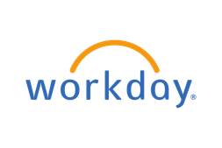







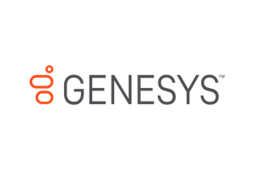
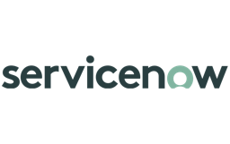

Driving value in high-impact domains
IBM has demonstrated value through its own implementations of watsonx Orchestrate to transform business operations. Explore the use cases and outcomes on the Client Zero Seismic page →
Human Resources
Who plays in this space
Client Zero
Relative Market Opportunity
AskHR
HIRO
HERMES
Use cases
Employee Support
Talent Acquisition
Onboarding
Human Resources
AI and automation are decisive factors in enabling a streamlined recruiting process, personalized career development, and improved employee engagement
Sales
Use cases
Sales Enablement
Sales Prospecting
Opportunity Management
AskSales
Sales Prospecting
Sales
Sales function is primed to quickly become a leading adopter of generative AI. AI-powered systems are on their way to becoming every salesperson’s and every sales manager’s indispensable digital agent.
Procurement
Use cases
Procure to Pay
Supplier Assessment
Opportunity Management
AskProcurement
Business process optimization
Procurement
AI is well-positioned to transform procurement operations to derive deeper insights, automate tactical tasks, and enable data-driven decision-making spanning contract lifecycles, predictive replenishment signals, and risk forecasting.
Customer Care
Customer support
800+ customers
Use cases
Customer self-serve
Modernize call center
Agent Assist
Customer Care
AI has historically been heavily adopted in this space to transform customer experience and reduce call center costs. Enterprises expect to leverage new agentic capabilities to modernize their existing assistant and chatbot solutions.
Others
Finance
Order to cash
Expense mgmt
Supply Chain
Order Management
Customer support
Other Enterprise Functions
AI is increasingly driving transformation across finance, supply chain, and beyond, accelerating tasks such as financial forecasting, inventory optimization and logistics coordination, while enhancing resilience and agility.
Notes:
The previously discussed shift in buyer behavior, away from experimentation and toward business impact, is particularly evident in domains that consistently deliver high value. IBM watsonx Orchestrate is strategically focused on addressing these critical areas: HR, Sales, Procurement, Customer Care, and IT.
These domains are filled with non-automated, high-volume workflows—manual, repetitive tasks that still consume significant time and resources. With more than seven years of internal implementation experience and deep engagements with clients, IBM understands the complexity and untapped potential across these functions. AI-powered orchestration offers an opportunity to radically improve operational efficiency, user experience, and responsiveness.
Importantly, this is not just a matter of process improvement. It is a transformation of how work gets done by embedding intelligent agents into everyday workflows and aligning them with existing systems, data, and decisions.
There is also powerful synergy between business process automation and software development productivity. For example, IBM watsonx Code Assistant plays a complementary role by accelerating code generation and modernization, aligning with IT departments seeking to automate development tasks and integrate with broader AI agent strategies. Together, these solutions address both the front and back ends of digital transformation.
Looking ahead to 2025 and beyond, watsonx Orchestrate is not only well positioned but essential for enterprises seeking to operationalize automation with speed, scale, and relevance.
Consider the scale of opportunity:
The HR automation market alone is projected to reach $56 billion by 2030¹
AI applications in HR are expected to exceed $15.24 billion²
These figures reflect more than market trends; they underscore a strategic imperative for clients to modernize critical business functions through AI. And they reaffirm IBM’s decision to focus investment, innovation, and partner engagement on domains that drive measurable impact.
Finally, IT and developer-facing use cases are a key part of this vision. Integrating software development into the broader agentic AI strategy ensures watsonx Orchestrate supports the full enterprise spectrum—from business users to developers and technical teams—strengthening IBM’s position as a leader in the next era of automation.
Links:
IBM Client Zero Seismic page: https://ibm.seismic.com/Link/Content/DC3FBFRjP8VpR8QPRHF9Xh7VfDdj
Sources:
¹ HR Management Market Size Forecasts, 2024 – 2030, Grand View Research, 2024: https://www.grandviewresearch.com/industry-analysis/human-resource-management-hrm-market
² Artificial Intelligence In HR Market Size Forecasts, 2024-2030, Grand View Research, 2024: https://www.grandviewresearch.com/industry-analysis/artificial-intelligence-hr-market-report

Slide 13
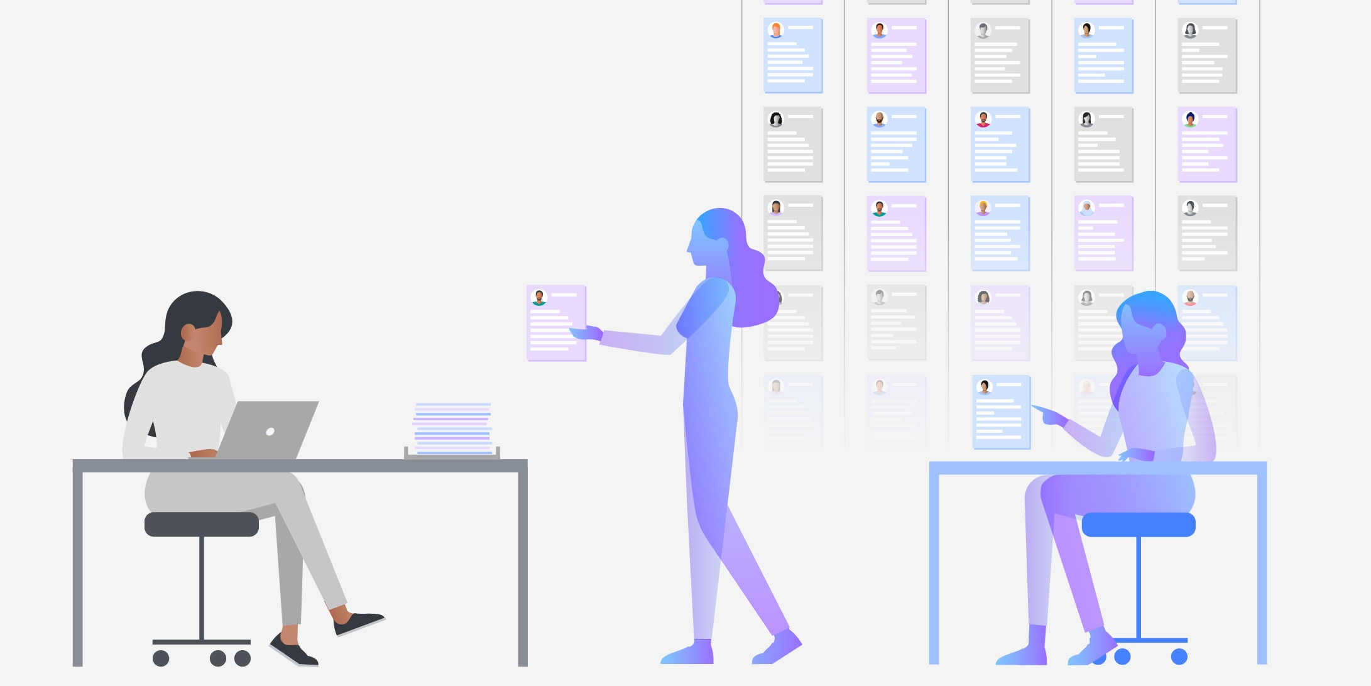
Let’s start with HR
Notes:
An exceptional opportunity exists for watsonx Orchestrate in the HR marketplace. IBM watsonx Orchestrate has successfully established a solid client base within clients’ HR departments, becoming one of the first departments to benefit from IBM's innovative AI assistant and agent solutions. The forthcoming slides in this section will highlight the key characteristics of the HR market space and how watsonx Orchestrate delivers enormous benefits.

Slide 14









HR orgs have many functions with few resources— all of which are ready for digitization
Select & analyze talent with a robust tool
Guide HR department through the onboarding process efficiently
Manage, track & report learning activities in a single location
Help the goal alignment, performance review, feedback processes
Manage budget and compensation process securely & accurately
Track company employees & the amount of money they are paid
Recruiting
Onboarding
Learning
Performance & Goals
Compensation & benefits
Payroll
Requisition posting
Sourcing candidates
Applicant tracking
Background checks
Interview & assessments
Offer management
Pre & post-hire verification
Provisioning & access management
New hire guidance
Employee Off-boarding
Recommending & tracking learning programs for compliance and upskilling based on job profiles & skills
Internal mobility
Employee self-evaluation
Manager performance evaluation
Calibration & feedback
Bonus planning
Compensation benchmarking
Tracking open enrollment, dependents, decisions
Payroll processing
Reporting
Audit & controls
Integrated time management
Employee management
Employee record management
Employee inquiry & self-serve
Compliance training & documentation
Demand forecasting & planning
People Analytics
Data integration across HR systems
Talent skill mapping
Staffing strategy
Succession planning
Notes:
In recent years, HR has faced significant scrutiny, driving a strong need for transformation through generative AI and automation. Historically, HR technology has operated in silos, with various tools failing to integrate smoothly, resulting in cumbersome manual data mapping between tasks. While some solutions address specific functions like talent selection and analysis, they often lack a comprehensive approach that spans the entire employee lifecycle.
Enter watsonx Orchestrate — an innovative AI agent platform revolutionizing talent recruiting and HR operations. By streamlining processes across recruiting, onboarding, learning, performance, compensation, benefits, and payroll activities, watsonx Orchestrate can unify fragmented systems into a single, cohesive platform.
This approach highlights the diverse roles that HR professionals juggle, each requiring its own set of tools and unique digital solutions. The HR domain presents a tremendous opportunity for digital transformation, particularly in automating key areas such as talent sourcing, expediting employee onboarding, managing learning and development programs, and conducting performance reviews.
By focusing on the six pivotal areas of HR shown on this slide—recruiting, onboarding, learning, performance, compensation, and payroll—organizations can identify precise opportunities for digitization. While some tools are available for individual tasks within the HR spectrum, watsonx Orchestrate stands out by enabling management of the entire HR process seamlessly, from job posting to offer management.
The capabilities of watsonx Orchestrate can significantly enhance HR functions, covering aspects like onboarding, enablement, pre- and post-hire verification, provisioning, access management, new hire guidance, and offboarding. Additionally, this platform facilitates a unified approach to managing, tracking, and reporting learning and enablement activities. Performance reviews can be effectively aligned with feedback processes, while compensation and benefits are managed securely and accurately, allowing for streamlined bonus planning, compensation benchmarking, and payroll tracking.
Embracing watsonx Orchestrate promises not only to improve operational efficiency but also to empower HR teams to deliver exceptional experiences throughout the employee lifecycle.

Slide 15






How watsonx Orchestrate helps HR: Cassie, the talent recruiter
Create
Source
Interview
Assess
Publish job description
Candidate search
Interview candidates
Collect feedback
Orchestrate helps Cassie, the talent recruiter
Easily create a job requisition & request approval through natural language while guiding her through the job requisition creation process
Source active & passive candidates through job postings and ThisWay Global’s candidate sourcing tool
Send job interview confirmations & candidate data to hiring managers
Collect & send her hiring committee feedback for review
So that Cassie can focus on…
Thoughtfully crafting & editing job descriptions to attract the best talent
Devising creative strategies to advertise open jobs. Screening candidates & preparing recommendations to hiring managers
Researching & preparing for interviews. Enabling hiring managers with impactful interview questions
Acting on declined candidates & moving accepted candidates to the next stage so the company doesn’t miss out on top talent
Benefits
Eliminate delays caused by coordination with multiple stakeholders
Empower sourcing & matching with passive, diverse candidates
Ensure a positive candidate interview experience
Reduce human error and processing time
Notes:
IBM watsonx Orchestrate revolutionizes the talent acquisition landscape for specialists like Cassie (the HR persona on this slide) and other HR professionals, empowering them to concentrate on high-value tasks. By automating repetitive and time-consuming processes, Cassie can redirect her energy toward strategic initiatives such as crafting compelling job descriptions for requisitions (reqs), designing innovative advertising strategies, thoroughly screening candidates, and delivering insightful recommendations to hiring managers.
Moreover, watsonx Orchestrate equips hiring managers with powerful interview questions and seamless onboarding support for new team members. Each column on this slide illustrates how watsonx Orchestrate streamlines the talent acquisition process, allowing professionals like Cassie to achieve greater efficiency and impact.
With the assistance of AI agents to handle mundane tasks, Cassie can focus on work that truly demands thoughtful consideration and strategic insight. For example, watsonx Orchestrate can effectively coordinate form requirements among various stakeholders, eliminating delays and minimizing human errors. Embracing this innovative tool not only enhances productivity but also maximizes the potential of HR teams, ultimately leading to more successful hiring outcomes.

Slide 16
How watsonx Orchestrate helps HR: Cade, the new hire
Understand
Guide
Do
Support
Learn about the tasks
Learn how to use the tools
Learn how to fill out a timesheet
Escalate to the right expert
Orchestrate helps Cade, the new hire
Understand all the onboarding steps to get started and ramp up in the new role
Learn how to use new tools that he does not use often (e.g. fill out timesheet)
Resolve critical items that block him from working on key projects
Reach the right expert to resolve issue quickly
So Cade can focus on…
Understanding new responsibilities & start planning to execute new tasks
Using the tools effectively to reduce the amount of time spent using them each week
Preparing and collecting the right insight needed to complete big projects
Completing the task at hand without being distracted from non-job related matters
Benefits
Fast-tracks employee to solution and reduces need for experts help
Reduces the need for employee to learn tools they don’t use often
Learn how to use tools effectively
Ensure a positive new hire experience
Notes:
In addition, watsonx Orchestrate empowers Cade, a newly hired employee (and the persona on this slide), to navigate unfamiliar processes with ease. This solution provides immediate access to crucial information needed for a smooth onboarding experience, helping Cade adapt to new tools and resources. When challenges arise, Cade can effortlessly escalate issues to connect with the right experts for guidance.
By leveraging watsonx Orchestrate, Cade can concentrate on high-value tasks, such as mastering their new role and responsibilities, effectively utilizing new tools, and completing assignments without being sidetracked by unrelated matters. For example, an onboarding agent can seamlessly guide new hires like Cade through essential tasks and procedures, like filling out timesheets, while also facilitating connections with experts if they face challenges related to signing up for benefits, obtaining passwords, or other vital resources. This not only enhances a new hire’s onboarding experience but also accelerates their productivity and integration into the team.

Slide 17






Orchestrator Agent Example Use Case: Manager Support
Conversation
Agentic orchestration
Agents, Assistants & Skills
I need to transfer Francesca Lopez to Katherine Howe before the holidays and before end of year.
Supervises and routes
AskHR Agent
AI Agent searches for the employee’s & the new manager’s details in the HR database & validates the transfer request
Task sequence
AskHR
AI Agent calls the Skill to complete the transfer with the information obtained from the HR database
Evaluates, plans & executes, including HITL as needed
Task 1:
Search
AI Agent Chat
Please confirm the employee transfer details…
Task 2:
Transfer employee
AI Agent generates & sends confirmation emails to current manager, employee & new manager with official status of the transfer as completed
Task 3:
Ask for confirmation
Task sequence
Task 4:
Generate email
The transfer request has been completed. Francesca Lopez will be transferred to Katherine Howe’s team starting 4/16/25.
Completes and confirms
Task 5:
Send email
Task sequence
The AI Agent continues by asking if there are further actions needed, such as confirming a salary increase, job posting, employee rewards...
Reflects and recommends
AskHR Agent
Notes:
In the example shown on this slide, watsonx Orchestrate helps a people manager seeking to facilitate the transfer of an employee, Francesca Lopez, to another manager. The Ask HR agent analyzes the request, efficiently breaking it down into clear, actionable steps: first, searching for Francesca Lopez; next, coordinating the transfer to the designated manager; and finally, crafting and sending a notification email to Francesca.
By systematically addressing each component of the request, the orchestrator for tools and agents executes these tasks seamlessly. This capability is made possible through robust integration with leading enterprise services such as Workday, SAP SuccessFactors, and Microsoft Outlook. The result is a streamlined process that enhances operational efficiency, reduces administrative burdens, and ensures a smooth transition for Francesca, benefiting both the employee and the organization. Embracing such advanced solutions transforms complex HR processes into straightforward, hassle-free experiences.
For certain use cases, including sensitive human resource (HR) matters such as salary increases and promotions, the process may require a human-in-the-loop (HITL) confirmation. This ensures the responsible use of AI agents. In this slide’s example, the manager is asked to confirm the transfer details before the AI agent completes the tasks of sending confirmation emails and updating the HR systems.
Definitions:
Human in the Loop (HITL): an AI approach where human oversight is integrated into automated processes to review, validate, or refine AI-generated outputs, ensuring accuracy, reliability, and compliance.

Slide 18
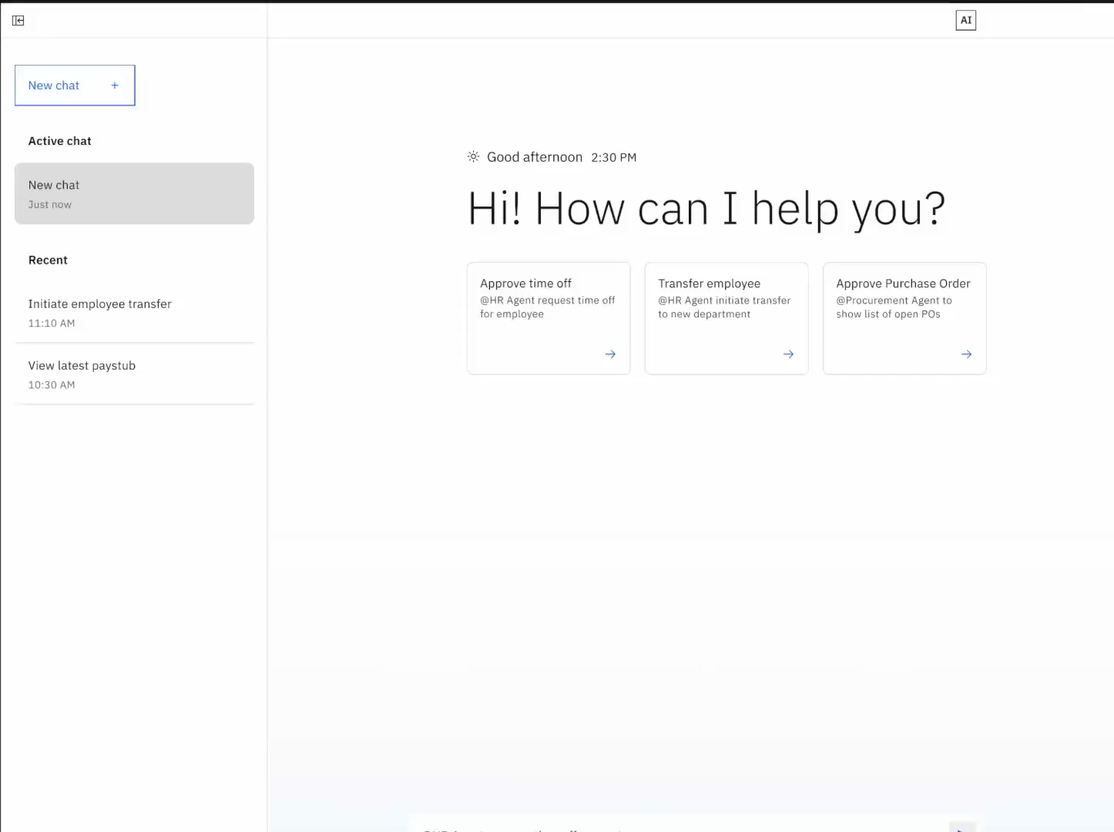
AI Agent for HR Demo
HR agents on Seismic →
Notes:
<DEMO VIDEO PLAYS AUTOMATICALLY WHEN IN PRESENTATION MODE>
This is a brief demo of the pre-built watsonx Orchestrate HR agent. It demonstrates how an AI agent can help a manager review and approve time-off or vacation requests. After the manager reviews and approves the request, this agent inquires whether the manager would like to notify each of their employees of the approval. When the manager agrees, the tool uses generative AI to create the emails, allowing the manager to review them all before sending.
Finally, the manager provides feedback to the agent that the experience was positive. This helps the agent improve its responses and performance based on continuous learning through user feedback.
This is just one of many example use cases — the watsonx Orchestrate HR Agent is ready to support dozens of common HR processes out-of-the-box (OOTB). These key processes are packaged in the domain agent and are easily configured through an intuitive catalog. Rather than starting from scratch and building out various integrations and workflows, organizations can leverage a tailored set of tools and agents (first built by IBM and partners and used inside of IBM) that expedite the initiation process. This approach not only accelerates deployment but also empowers businesses to extend and evolve their capabilities over time.
For more comprehensive insights on effectively engaging with HR organizations, sellers should review the Seismic resources at: https://ibm.seismic.com/Link/Content/DCWBHj6fdj9CT82Xgmp3Q47PQCQj#/?anchorId=0f8d3eb9-e73f-44c1-bcd9-fcc20f9b4a9e.

Slide 19

Procurement & sales use cases
Notes:
The following slides demonstrate how IBM watsonx Orchestrate adds value to procurement and sales use cases.

Slide 20
How watsonx Orchestrate helps procurement: The project delivery executive
Aggregate
Refine
Engage
Select
Collate requests
Complete and submit requisition
Engage with prospective suppliers
Review & select supplier
Orchestrate helps the project delivery exec
Easily collate requests from multiple sources with diverse data points into a single file filtered for prerequisites using natural language
Automatically creates requisition on procurement system (VMS) and asks suppliers for missing information
Monitor VMS for requisition updates, review summarized qualifications, share profiles with team and set up preliminary meetings
Manage selection process on VMS, remove declined suppliers, invite chosen supplier to onboard and generate PO
So they can focus on…
Building the right business case to win stakeholder sign off and expense approvals
Defining project deliverables and planning project details, timeline and budget
Ensuring shortlisted suppliers meet project requirements
Finalizing supplier relationship with stakeholders and preparing to deliver on project goals
Benefits
Eliminate delays caused by coordinating multiple requests and approvals
Ease matching with multiple suppliers and complete required info
Ensure a positive experience with the right suppliers
Reduce processing time and onboard quickly
Procurement agents on Seismic →
&
Notes:
Similar to the HR example, this self-explanatory slide shows a project delivery persona in a procurement use case. The project delivery executive in this example can use watsonx Orchestrate to collate requests, complete and submit requisitions, and engage with prospective suppliers — all without needing extensive involvement from procurement specialists.
This approach eliminates delays caused by coordinating multiple requests and approvals, eases matching with multiple suppliers to complete required information, ensures a positive experience with the right suppliers, and reduces processing time for quick onboarding. For more information, sellers should visit the AI agents for Procurement Seismic page at: https://ibm.seismic.com/Link/Content/DCTQGRfqgWjJ78fTGb26JHMJ2BpG.
Terminology:
PO: Purchase Order
VMS: Vendor Management System

Slide 21
How watsonx Orchestrate helps procurement: The new supplier
Understand
Guide
Do
Support
Learn about the supplier contract
Learn how to use the tools
Submit timely project invoices or updates
Find the right expert
Orchestrate helps the new supplier
Understand important terms within the supplier contract through a detailed summary of the most important points
Onboard to new company systems & learn how to use new tools that will allow the project to run smoothly
Perform scheduled reporting tasks such as submit invoices or project updates automatically
Reach the correct expert or stakeholder for support for questions or in addressing challenges
So they can focus on…
Organizing the new project to make sure it is successful start to finish
Getting up to speed quickly and reducing the time to effectively deliver on contract terms
Monitoring project success metrics, troubleshooting & performing strategic work
Solving problems quickly to ensure the project does not go off track
Benefits
Fast-track access to information & reduce need for expert help
Reduce learning time for new tools
Automate busy-work so the supplier can focus on higher value tasks
Ensures no down time while looking for the right support
Procurement agents on Seismic →
Notes:
This self-explanatory slide presents another persona in the procurement process – a new supplier aiming to onboard with an enterprise. IBM watsonx Orchestrate assists this new supplier in understanding key points in their supplier contracts, mitigating potential risks.
Once approved, watsonx Orchestrate guides the supplier through the onboarding process for the enterprise's procurement systems and tools. Additionally, watsonx Orchestrate can assist the supplier with scheduled reporting tasks and project updates, and if needed, route them to the proper support channel.
For more information, sellers should visit the AI agents for Procurement Seismic page at: https://ibm.seismic.com/Link/Content/DCTQGRfqgWjJ78fTGb26JHMJ2BpG.

Slide 22
How watsonx Orchestrate helps sales: The seller
Generate
Match
Automate
Connect
Generate a list of eligible customers
Match appropriate products to customers
Automate outreach to take the next step
Schedule customer meetings or send more product info
Orchestrate helps the seller
Generate a list of relevant customers based on segmentation and KPIs using natural language
Match customers to products specifically tailored to their needs
Generate and send engaging emails to customers that address their specific needs
Schedule meetings that suit everyone’s availability or send more information to the customer
So they can focus on…
Understanding business priorities in greater detail and strategic planning
Continuing to learn more about the specific products customers are eligible for and building more volume in sales pipeline
Iterating on product and presentation collateral to ensure it leads to a conversion
Preparing for customer questions and concerns
Benefits
Eliminate delays caused by manually finding customer opportunities
Reduce decision making time by matching customers to new products automatically
Ensure messaging and engagement material is on target and fast
Remove busy work involved in finding the right time to make the sale
Sales agents on Seismic →
Notes:
This self-explanatory slide shows how watsonx Orchestrate can help sellers conduct prospecting exercises. For example, it can generate a list of customers eligible for new offers and then match those customers with the appropriate products for upsell opportunities.
IBM watsonx Orchestrate can also generate emails that enable sellers to perform any necessary outreach steps. Additionally, it can assist sellers in scheduling their client meetings and sending more product information to their prospects. This not only eliminates busy work and enhances efficiency but also improves quality and accuracy in targeting the right prospects with the appropriate messaging and engagement materials.
For more information, sellers should visit the AI agents for Sales Seismic page at: https://ibm.seismic.com/Link/Content/DCWBHj6fdj9CT82Xgmp3Q47PQCQj#/?anchorId=2679d8ae-4240-45c0-9a33-a10843e3c433.
Terminology:
KPI: Key performance indicator

Slide 23
How watsonx Orchestrate helps sales: The new customer
Understand
Guide
Do
Support
Schedule appointment or sign up for new product
Learn about the product offers
Guide to the right offer
Find the right sales expert
Orchestrate helps the new customer
Understand the product options more quickly
Find the right product offer that fits their needs the most
Effortlessly accept an appointment time or buy the product directly
Reach the right sales expert to help them with their product choice
So they can focus on…
Getting on with their day without spending more time than they want on it
Learning important product details quickly & making an informed decision
Getting on with their day without spending more time than they want on it
Making sure they are choosing the right product
Benefits
Fast-track customers to solution and reduce the need for basic help
Reduce the time needed to vet multiple product offers
Automates busy-work so customer can focus on more important things
Ensure a positive customer experience
Sales agents on Seismic →
Notes:
New customers coming to a brand to purchase a product can now use an AI agent to learn about that product. IBM watsonx Orchestrate can guide them to the right offer and help them understand the best plan for that product. It can schedule appointments and direct customers to find the right sales expert who can assist them in making their purchase. This self-explanatory slide illustrates a new customer persona as they navigate the buying journey. This expedites customers toward the right solution, ensuring a positive customer experience.
For more information, sellers should visit the AI agents for Sales Seismic page at: https://ibm.seismic.com/Link/Content/DCWBHj6fdj9CT82Xgmp3Q47PQCQj#/?anchorId=2679d8ae-4240-45c0-9a33-a10843e3c433.

Slide 24





Orchestrator Agent Example Use Case: Sales Prospecting
Conversation
Agent orchestration
Agents, Assistants & Skills
What are the sales plays we have for digital labor?
Supervises and routes
AskSales Agent
Seismic has the following sales plays:
Digital Labor in HR
Digital Labor in Sales
Digital Labor in Procurement
AskSales
Task in sequence
Finds relevant sales plays
Can you get a list of accounts and filter them by industry with the most relevant contacts for each?
Prospecting Assistant
Here are the accounts and contacts by industry:
Reflects, reasons and plans
Retrieves list of accounts in my territory
Filters accounts by industry
Identifies relevant contact
AI Agent Chat
HR
Account 1
Contact 1
…..
Sales
Account 2
Contact 2
…..
Can you search any context on <account name>?
Search Agent
Task in sequence
Finds details on relevant account activity
<account name> is up for renewal next month and has increased head count by 20%.
Generate email skill
Write a standard renewal check-in email with a focus on the HR value proposition and send to <contact name> at <account name>.
Recognizes, connects and executes tasks
Generates email with value propsition
*Generate email skill provides email text and employee can send email directly from unified chat.
Send email skill
Completion, next task or new domain
Sends email to contact
Notes:
This slide illustrates how IBM’s AskSales AI agent effectively manages a series of requests, empowering users to gain insights into current sales plays, acquire a targeted list of accounts that align with specific user criteria, gather new intelligence for particular accounts, and seamlessly send renewal proposals tailored to user requests.
The entire process can operate without any human intervention – executing completely in an autonomous manner without a human in the loop (HITL).

Slide 25
watsonx Orchestrate product capabilities
Notes:
This section covers the architecture and capabilities of watsonx Orchestrate.

Slide 26











The multi-agent architecture in action
Customer verification and onboarding
Interaction
Orchestration Agent orchestration
Collaboration Multi-agent orchestration
Tool use Agents exposed as tools
“I need to onboard a new client called Focus Corp”
Company profiling agent
Agents
APIs & Apps
Chat
Actions and dialog flows
Knowledge (documents)
Slack
Customer verification agent
Agentforce
Onboarding agent
Customer Success Manager
Voice
Business automation flows
Pro-code tools
Legal advisor agent
Data sources (SQL, etc.)
Built-in tools (web search…)
Tool catalog Discovery and binding
Notes:
To illustrate how watsonx Orchestrate operates in a real-world scenario, consider a Customer Success Manager (CSM) responsible for onboarding a new client, Focus Corp.
The manager in this example initiates the process by interacting with watsonx Orchestrate through one of several available enterprise channels, such as Microsoft Teams, Slack, or a customer service portal. IBM watsonx Orchestrate interprets the request and intelligently matches it to the appropriate Customer Verification Agent, automatically triggering the orchestration engine.
From there, Orchestrate dynamically assembles a plan, identifying the right agents from the catalog and coordinating their execution. Each agent brings specialized capabilities and can access a tailored set of tools to complete specific parts of the overall task.
For example:
The Company Profiling Agent is configured with premium data tools from Dun & Bradstreet, enabling real-time access to verified business insights.
The Onboarding Agent operates through Salesforce Agentforce, ensuring that all customer records, account hierarchies, and onboarding workflows are created within the client’s customer relationship management (CRM) environment.
IBM watsonx Orchestrate seamlessly manages this diverse set of agents, even when they are distributed across different platforms or hosted in different environments. This heterogeneity is a core strength of the platform, allowing enterprises to orchestrate work across proprietary systems, third-party platforms, and hybrid infrastructures.
In this example, a complex, multi-step workflow is handled efficiently, transparently, and with minimal human intervention, demonstrating how watsonx Orchestrate delivers intelligent automation at scale.

Slide 27
The multi-agent architecture in action
Customer verification and onboarding
Interaction
Orchestration Agent orchestration
Collaboration Multi-agent orchestration
Tool use Agents exposed as tools
“I need to onboard a new client called Focus Corp”
Customer verification agent
Company profiling agent
Agents
APIs & Apps
Chat
Toolset
Tools
Agents
Actions and dialog flows
Knowledge (documents)
Slack
Get case data
Company prof’g
Agentforce
Doc processing
Onboarding
Legal advisor
Onboarding agent
Customer Success Manager
Voice
Knowledge
Business automation flows
Pro-code tools
Documents
Glossary
Policies
Customer
Company info
Sales contract
Behavior
Legal advisor agent
Data sources (SQL, etc.)
Built-in tools (web search…)
Guidelines
Channels
When x then y
Web chat
Tool catalog Discovery and binding
Slack
Notes:
Continuing the customer onboarding example, this slide introduces the core framework used to define and manage agents in watsonx Orchestrate. This framework is designed to abstract complexity while providing the flexibility enterprises need to scale intelligent automation.
Each agent in watsonx Orchestrate is defined through three key components: Toolset, Knowledge, and Behavior. Specifically:
Toolset defines what the agent is capable of doing. The toolset includes:
Custom-built tools developed within the enterprise to execute specific actions.
Third-party or open-source tools, which can integrate diverse services and APIs.
Other agents, which can be called upon as collaborators, enabling task delegation and multi-agent orchestration.
The toolset provides the functional foundation for how an agent completes its tasks—whether it’s retrieving data, updating systems, or interacting with users.
Knowledge. Agents can be grounded in domain-specific documents, knowledge and terminology, ensuring contextual relevance. This allows agents to:
Understand industry-specific concepts.
Communicate using the language of the business unit, such as HR, procurement, customer care, and so on.
Apply policy and operational logic that reflects enterprise practices.
Grounding agents in knowledge enhances their precision and adaptability within domain workflows.
Behavior. Agent behavior is managed through configurable guidelines and interaction preferences. Enterprises can:
Define how agents respond across various communication channels.
Apply guardrails to ensure compliant, brand-aligned interaction.
Adjust tone, escalation logic, and fallback behaviors to reflect organizational norms.
These behavioral configurations ensure that agents act responsibly and consistently, aligned with enterprise standards for governance, tone, and user experience.
This modular framework—Toolset, Knowledge, and Behavior—allows clients to create powerful, reusable agents tailored to enterprise environments. In the onboarding example, each agent in the orchestration flow brings its own combination of these components, enabling them to work together effectively while maintaining flexibility, control, and accountability.

Slide 28



Agentic AI in watsonx Orchestrate
IBM’s Unique Approach
Orchestrator for Tools and Agents
AI AgentOps
Multi-agent, multi-tool supervisor, router, and planner which facilitates complex task execution
Discover, manage, monitor & optimize autonomous AI agents
Agent Marketplace and Prebuilt AI Agents
Accelerate AI Agents with pre-built utility agents and domain agents. Provide an easily searchable catalog of AI agents and tools.
Build Your Own Agents
Build custom designed agents with pro-code to no-code tooling
Integrate 3rd party agents built in any tool or framework
Notes:
As enterprises navigate an increasingly complex landscape of AI agents, copilots, and business applications, the question is not whether to adopt agentic AI, but how to do it effectively, at scale, and with control. To meet this challenge, watsonx Orchestrate delivers a targeted, enterprise-ready framework organized around four strategic pillars. These pillars define how organizations can orchestrate intelligent work, accelerate time-to-value, build custom agents, and operate with confidence.
Together, these capabilities form a comprehensive, modular approach that enables clients to unify tools, drive outcomes across domains, and build on a platform built for scale and trust.
This slide briefly introduces each pillar before exploring them in more detail:
Orchestrator for Tools and Agents: Enables multi-agent, multi-tool orchestration across existing systems, unlocking AI-driven productivity.
Prebuilt AI Agents: Provides ready-to-use agents for high-value domains, accelerating deployment and return on investment (ROI) from day one.
Build Your Own Agent: Offers no-code and pro-code options for developing and deploying custom agents on a unified platform.
AI AgentOps: Delivers enterprise-grade management, monitoring, and governance to keep agent performance aligned with business goals.
This framework is not just comprehensive—it’s essential for enterprises that want to lead in the next wave of AI-driven transformation.

Slide 29
Agentic AI in watsonx Orchestrate
IBM’s Unique Approach
Orchestrator for Tools and Agents
AI AgentOps
Multi-agent, multi-tool supervisor, router, and planner which facilitates complex task execution
Discover, manage, monitor & optimize autonomous AI agents
Agent Catalog and Prebuilt AI Agents
Accelerate AI Agents with pre-built utility agents and domain agents. Provide an easily searchable catalog of AI agents and tools.
Build Your Own Agents
Build custom designed agents with pro-code to no-code tooling
Integrate 3rd party agents built in any tool or framework
Notes:
The slides in this section provide a deeper exploration of the Orchestrator for Tools and Agents capability in watsonx Orchestrate.

Slide 30

















Agentic orchestration in watsonx Orchestrate
Overview
Benefits
To drive productivity, enterprises need multiple agents across multiple domains to execute their complex use cases.
IBM offers a multi-agent, multi-tool supervisor, router, and planner to facilitate complex task execution across your agent landscape.
Open and hybrid – unifies IBM and 3rd party agents (opensource or 3rd party vendors) to fulfill workflows across app and data
Easy to scale and innovate – a native multi-agent collaboration framework does not require developer expertise to configure
Flexibility to incorporate 3rd party solutions and deploy anywhere for enhanced collaboration & customer/employee experience
Multi-agent and assistant Orchestration
Collaborator Agents & Tools
Client Layer
Agentic Orchestration
Domain Agent
Agents
APIs & Apps
Ariba
HR, Procurement, Sales, etc.
End User
Agent 1
Tool Catalog (Discovery and Binding)
Actions and Dialog Flows
Knowledge (Documents)
wxO Agent Builder & SDK
BYOA
Business Automation Flows
Pro-Code Tools
Data Sources (SQL, etc.)
Built-In Tools (Web search, …)
3rd-Party Agents
Data Sources (SQL, etc.)
Built-In Tools (Web search, …)
30
Notes:
At the core of watsonx Orchestrate is a powerful, large language model (LLM)-powered agentic orchestration layer, IBM’s answer to the complexity of modern enterprise automation. This supervisory layer intelligently coordinates tasks across multiple agents, assistants, tools, and systems, transforming fragmented workflows into cohesive, scalable operations.
Enterprises cannot rely on a single agent or solution to handle the full range of use cases, domains, and channels. Business environments are too diverse and dynamic for siloed automation. That’s why multi-agent orchestration is foundational—it enables collaboration across agents and tools through a single point of interaction, driven by natural language and enterprise context.
This orchestration layer:
Understands user intent using LLMs
Matches tasks to the right assets: agents, assistants, skills, automations, or APIs
Supports workflows that span departments, domains, and systems
Connects directly to a vast ecosystem of enterprise applications
The orchestrator agent is analogous to the hub of a wheel, intelligently routing requests and coordinating execution across a distributed set of capabilities, regardless of whether they’re built by IBM, third-party vendors, or clients themselves. This open approach ensures clients can extend and integrate without needing to rip and replace existing investments.
What makes IBM’s approach unique is its focus on incremental adoption and interoperability. Enterprises can launch quickly, scale gradually, and connect agents from multiple sources, leveraging their current infrastructure while embracing next-generation AI.
The result is a consistent and intelligent user experience that enables employees and customers to complete tasks across systems using natural language. Whether the request involves onboarding, document processing, accessing enterprise knowledge, or escalating to a human, the orchestrator plans, routes, and executes seamlessly.
In summary, agentic orchestration empowers enterprises to:
Unify their AI ecosystem under a single control plane
Maximize productivity across use cases and departments
Scale with flexibility, trust, and speed
IBM watsonx Orchestrate delivers this orchestration framework, turning AI assistants and agents into a coordinated, enterprise-grade digital workforce.
Terminology:
BYOA: Bring your own agent
SDK: Software development kit

Slide 31







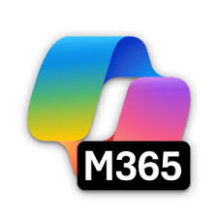













Example: Complementing Microsoft Copilot in HR employee support
Collaborator Agents
IBM watsonx Orchestrate
Sales agents
End- User Interface
Context: Employee Support for HR
End User
IBM watsonx Orchestrate
Business Tool Catalog
Orchestrator Agent
Pre-built domain agents
IBM embeddable chat
Build custom agents for business automation
Notes:
This slide illustrates how watsonx Orchestrate enhances and extends the capabilities of existing AI assistants, such as Microsoft Copilot, by orchestrating across a broader network of agents, tools, and enterprise systems.
In this HR support example, an employee initiates a request through a familiar Copilot chat interface. Instead of being limited to what the Copilot agent can do alone, watsonx Orchestrate steps in as the orchestration layer, dynamically identifying and coordinating the right resources to fulfill the request.
This agent orchestrator understands the end user’s intent in the context of the enterprise and assembles a plan that spans multiple systems and agent types. This includes:
A Salesforce Agent to access employee or account information
Additional Copilot agents integrated into other parts of the business
The watsonx Orchestrate catalog agents and tools, purpose-built for HR
By bringing these assets together, the end user receives a complete, seamless experience—regardless of where the capabilities originate. This approach demonstrates four key differentiators of watsonx Orchestrate:
Unified Orchestration Across the Enterprise. IBM watsonx Orchestrate brings together disparate agents, apps, and automations into a cohesive, LLM-powered workflow, removing silos and delivering business outcomes through a single touchpoint.
Fast Time-to-Value. Domain-specific, prebuilt agents for HR, procurement, and customer care enable clients to activate high-ROI use cases quickly, with minimal configuration.
Openness and Interoperability. The platform is designed to work with third-party agents, SaaS applications, and public cloud environments—including Microsoft and Salesforce ecosystems, ensuring that existing investments continue to deliver value.
Flexible Agent Development. Business and technical users can build and extend agents in a low-code studio, combining LLMs, automation, and enterprise data without complex development cycles.
In summary, watsonx Orchestrate doesn’t compete with existing assistants, it amplifies them. By serving as an intelligent coordinator behind the scenes, it ensures that enterprises can deliver unified, high-value experiences across tools, platforms, and business domains.
A demonstration of this use case can be found in the client presentation at: https://ibm.seismic.com/Link/Content/DCqd9cB4HbG6jGmH4VjTgjQWpfP8.

Slide 32

Why agent orchestration matters: A side-by-side comparison
No orchestration
Agentic orchestration
Multiple entry points, fragmented experience
Unified experience
Unified Assistant
Agent orchestration
Employee HR agent
Supplier Risk agent
Sales Prospecting agent
LLM agent facilitates the UX
Routing
Disambiguation
Tool calling
Reasoning
Planning
Limited to single-agent use cases
Minimal coordination with backend tools
Static, task-specific interaction flows
Difficult to scale across business units
ROI limited to surface-level engagement
Multi-agent collaboration across systems
Centralized task routing & supervision
Dynamic, multi-turn conversations
Seamless integration with enterprise tools
Fast time-to-value and high scalability
Notes:
This slide presents a visual comparison between two approaches to AI-driven experiences.
On the left is a common scenario: a generative AI assistant, agents or copilots operating in isolation. These solutions are typically limited to single-channel, single-agent use cases. While useful for basic inquiries, they lack the depth to handle cross-functional tasks, coordinate with other systems, or evolve with changing business needs.
On the right is a more advanced model, powered by the watsonx Orchestrate’s agent orchestration. Here, generative AI is not just a chat interface—it becomes part of a coordinated ecosystem where agents, tools, and automation collaborate to deliver richer outcomes. The orchestrator plans, routes, and supervises each task, seamlessly blending multiple agents, systems, and interactions into one unified experience.
To guide client conversations, sellers can pose three strategic questions:
Integration – How are AI agents being integrated into existing digital workflows and task automation efforts?
Investment Maximization – How are current generative AI investments (chatbots, copilots) being extended for broader return on investment (ROI)?
Experience Control – How is control maintained over user experience and task execution as agentic AI becomes more dynamic and autonomous?
These questions reveal key pain points that the Orchestrator agent directly addresses.
Key Benefits of agent orchestration:
Enhanced User Experience. Multi-turn, intelligent conversations that go beyond simple Q&A, enabling agents to collaborate and resolve complex requests in a natural, flexible way.
Lower Total Cost of Ownership. Tasks are completed more efficiently with less manual oversight. Organizations can scale automation across functions without building and managing one-off solutions.
Operational Agility. As needs evolve, the orchestrator framework allows enterprises to rapidly deploy new agents, workflows, or integrations, without disruption.
In summary, the agent orchestrator is more than just a routing layer—it’s the strategic enabler of a modern AI experience. It allows clients to fully realize the promise of AI by orchestrating the intelligence, connectivity, and adaptability needed for enterprise-scale outcomes.
Terminology:
LLM: Large language model
UX: User experience

Slide 33
Agentic AI in watsonx Orchestrate
IBM’s Unique Approach
Orchestrator for Tools and Agents
AI AgentOps
Multi-agent, multi-tool supervisor, router, and planner which facilitates complex task execution
Discover, manage, monitor & optimize autonomous AI agents
Agent Catalog and Prebuilt AI Agents
Accelerate AI Agents with pre-built utility agents and domain agents. Provide an easily searchable catalog of AI agents and tools.
Build Your Own Agents
Build custom designed agents with pro-code to no-code tooling
Integrate 3rd party agents built in any tool or framework
Notes:
This section focuses on the second watsonx Orchestrate capability pillar: Prebuilt AI Agents and the Agent Catalog. This set of capabilities accelerates adoption by giving enterprises immediate access to trusted agents and tools—both horizontal utility and domain-specific agents and tools for functions like HR, Procurement, and Customer Care.
IBM watsonx Orchestrate’s catalog is designed for discoverability and reuse, enabling faster deployment, greater standardization, and higher return on investment (ROI) across enterprise automation initiatives.

Slide 34
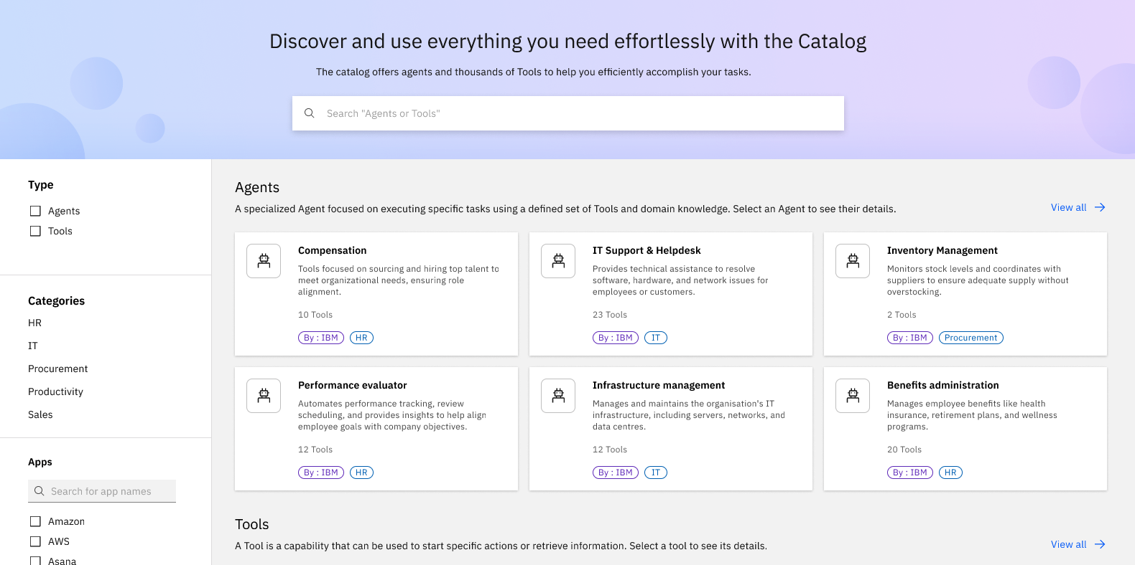
AI Agent & Tool Catalog
Overview
Benefits
The Agent and tool catalog allows agent builders to discover and connect to a multitude of agents, collaborators and tools to enhance agent capabilities in an easily searchable and intuitive interface.
Easily discover and connect to IBM, partner, and client-built agents and tools
Click into agents to see what tools they use and edit based on desired characteristics
Use agents as templates for faster customization and deployment
Notes:
IBM watsonx Orchestrate includes a powerful, enterprise-ready Agent and Tool Catalog—a centralized, searchable environment designed to accelerate agent adoption and reuse across the business.
The catalog allows agent builders to:
Discover and connect to IBM-built, partner-built, and custom agents and tools from across the enterprise
Browse by domain, application, or capability, with filtering and search features that surface the most relevant agents and tools for a given task
Preview agent configurations, including tool usage, collaborator agents, and embedded logic—without needing to enter the build interface
Use agents as templates, enabling rapid customization, refinement, and deployment
This environment brings together agents across functional domains such as HR, Procurement, Sales, Customer Care, and more, featuring integrations with leading enterprise platforms like Salesforce, Box, and Oracle Human Capital Management (HCM). Teams can also publish their own agents to the catalog, enabling reuse and governance at scale.
The prebuilt enterprise-proven domain agents are particularly impactful. These are AI agents tailored to high-value enterprise functions, pre-integrated with relevant systems and equipped with ready-to-use tools and workflows. By using these agents, enterprises can avoid starting from scratch—accelerating time-to-value while reducing development overhead.

Slide 35
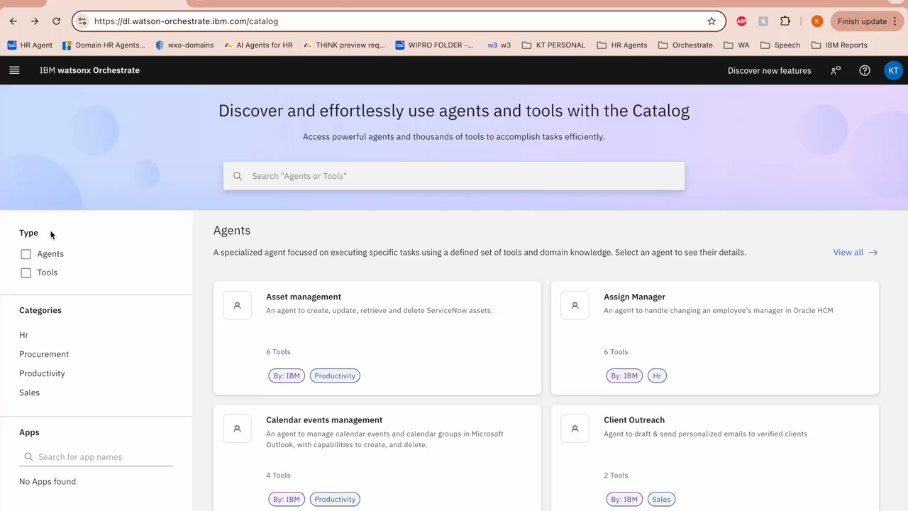
Demo Agent Catalog
Discover and connect to existing agents and tools
Use existing agents as templates with customization for faster deployment
Notes:
This slide demonstrates the watsonx Orchestrate Catalog.
<CLICK TO PLAY DEMO>
[0:00–0:20] — Catalog Browsing and Agent Selection
In watsonx Orchestrate, the Agent and Tool Catalog serves as a central hub for discovering and configuring AI agents. Here, a business user locates the Employee Support Manager Agent—a prebuilt solution designed to assist with HR-related requests.
[0:21–0:35] — Collaborator agents
In the Agent Overview, the user can explore other agents to which this agent can delegate tasks. [Pause until 0:36.]
[0:36–0:58] — Configure the agent or use it as a template for a new agent
The user could now customize the agent or use it as a template to create a new agent. The user chooses to use this agent as a template for a new agent. [Pause until 0:58]
[0:58–1:13] — Create a new agent from a template
To customize the agent for the current year, the user uploads a benefits document, grounding the agent in current healthcare plans and company-specific offerings. With this knowledge embedded, the agent is now ready to answer employee questions about plan details, comparisons, and personalized recommendations, all in natural language.
[1:13–2:10] — Testing the Agent
The user updates the description of the agent, and then reviews the agent’s knowledge base, which should match its purpose. Once the user is satisfied, they can quickly tests the agent to ensure it can provide accurate responses from the uploaded knowledge base. This validates that the new agent can deliver meaningful support right out-of-the-box (OOTB). In just seconds, the agent demonstrates its ability to understand and respond accurately, drawing from the newly added benefits content, with traceability embedded directly into its answer.
[2:11–2:33] — Exploring Collaborator Agents and Tools
watsonx Orchestrate supports collaborative agents, allowing multiple agents to work together in a unified task flow. Here, the user demonstrates how to add an existing AI assistant, built with IBM watsonx Assistant, as a collaborator to the new agent. [Pause until 2:33.]
[2:34–2:53] — Integrating External Agents and Tools
The user also explorse adding an external agent, demonstrating the platform's flexibility in integrating agents from other frameworks or vendors. Tools can also be added, bringing in external systems, APIs, or business logic. This enables the agent to act, not just respond, by connecting to enterprise systems to complete tasks.
[2:54–3:01] — Defining Behavior and Guardrails
Agents can be configured with clear behavioral rules—defining how to respond, prioritizing tasks, and avoiding specific actions. These guidelines ensure responsible, enterprise-aligned performance at scale.
[3:02–END] — Enabling Access Channels, Deployment, and Summary
Access is configurable. Web chat is available by default, but additional channels—like Slack or Microsoft Teams—can be enabled in seconds.
With setup complete, the agent is deployed—instantly available to support employees with timely, contextual responses.
Whether enhancing HR support, automating workflows, or accelerating service delivery, watsonx Orchestrate puts enterprise-grade AI in the hands of business users. It’s powerful, configurable, and ready for work today.

Slide 36





With IBM Agent Connect, ISVs can publish to the Agent & Tool Catalog
Partnering for scalable AI agent ecosystems
Key Benefits
Framework agnostic
Standardized communication
Multi-agent collaboration
Enterprise integration
Simplified development
Partner agent
Test & self- certify agent
Submit for publication in Agent Catalog
Use Cases
Agent specialization
Multi-agent workflows
Enterprise integration
Collaborative problem solving
Tool sharing
Publish to Agent Catalog
Partner agents available for use
Technical documentation →
Notes:
IBM Agent Connect is a strategic partner program designed to expand the watsonx Orchestrate ecosystem by enabling independent software vendors (ISVs) to build agents natively on this platform or seamlessly connect agents developed elsewhere.
At the core of this program is the Agent Connect Framework, a foundational integration architecture that provides standardized communication protocols, enabling smooth interoperability between third-party agents and watsonx Orchestrate. This allows external agents to participate in orchestrated, multi-agent workflows alongside IBM-built agents, tools, and enterprise automations.
Through Agent Connect, partners can publish their agents to the watsonx Orchestrate Catalog, enhancing discoverability while delivering value through vertical specialization and cross-vendor collaboration.
Key benefits of Agent Connect include the following:
It is framework agnostic, so it supports diverse architectures and agent runtimes.
It provides standardized communication, by simplifying connectivity and control.
Using multi-agent collaboration enables distributed workflows across vendors.
Its enterprise integration capabilities connect agents to enterprise-grade systems and APIs.
The simplified development framework reduces onboarding friction for external developers.
The following are some example use cases that can be built with Agent Connect:
Agent specialization with domain-specific agents, such as for Finance, Legal, or Procurement.
Multi-agent workflows, orchestrating complex tasks across multiple providers.
Skill sharing, with external agents offering specialized capabilities into shared workflows.
Enterprise integration, connecting to SaaS tools like Salesforce, Workday, or Oracle Human Capital Management (HCM).
Collaborative problem solving, by enabling teams of agents to solve cross-functional requests.
Agent Connect enables watsonx Orchestrate to scale horizontally across ecosystems, helping clients build diverse, high-performing agent networks without vendor lock-in.
The technical documentation is available at: https://connect.watson-orchestrate.ibm.com/introduction.

Slide 37




































A growing ecosystem of agent catalog contributing partners
Notes:
IBM watsonx Orchestrate is not just a standalone platform, it is the center of a rapidly expanding ecosystem built for enterprise flexibility, interoperability, and scale.
IBM works closely with leading technology providers to ensure that watsonx Orchestrate integrates with the systems, applications, and cloud environments clients rely on most. These strategic partnerships (some of which are shown on this slide) enhance the platform’s reach, simplify deployment, and accelerate time-to-value for critical business use cases.
This ecosystem is designed to offer clients choice and control, allowing deployment in hybrid or multi-cloud environments and enabling orchestration across third-party agents and services.
The following links provide some ecosystem highlights by partnering with companies like AWS, Salesforce, and Oracle:
AWS: A planned integration with Amazon Q Index will allow clients to create AI agents grounded in enterprise knowledge spread across multiple third-party applications—making it easier to act on centralized data repositories. More information is available at: https://newsroom.ibm.com/think-aws-and-ibm-continue-deep-collaboration-to-deliver-new-agentic-ai-capabilities.
Salesforce: IBM and Salesforce are co-developing prebuilt sales agents that bring together watsonx Orchestrate and Agentforce, enabling intelligent sales workflows that connect seamlessly into CRM systems. More information is available at: https://newsroom.ibm.com/think-ibm-and-salesforce-activate-enterprise-data-on-ibm-z,-preview-new-agents-to-help-customers-unleash-their-data-for-agentic-ai.
Oracle: watsonx Orchestrate and watsonx.ai are now certified to run on Oracle Cloud Infrastructure, and are natively integrated with Oracle HCM (Human Capital Management), powering domain-specific agents across HR functions. More information is available at: https://newsroom.ibm.com/2025-05-06-ibm-and-oracle-expand-partnership-to-advance-agentic-ai-and-hybrid-cloud.
IBM’s partner ecosystem continues to grow, and with it, the ability for clients to:
Deploy in the environment of their choice
Integrate with strategic platforms without vendor lock-in
Leverage trusted third-party solutions in orchestrated AI workflows
These partnerships are a critical enabler of IBM’s open approach to agentic AI, ensuring that watsonx Orchestrate works across the modern enterprise technology stack.

Slide 38
Accelerate results with IBM’s prebuilt domain AI agents
Human Resources Agents
Sales
Agents
Procurement
Agents
Employee Support
Prospecting, Client Search, Sales Research, Product Enablement, CRM Management, Client Outreach
Purchasing, Supplier Management
40% reduction in HR operating1
9hrs saved per week w/sales enablement2
70% improvement in cycle time for sourcing & contracts3
watsonx Orchestrate
Use cases
Request time off
Update home address
View compensation history
View benefit enrollments
Location transfer request
Initiate promotion
Update salary details
...and more!
Tools
SAP SuccessFactors
Workday
Use cases
Identify relevant products
Summarize key selling points
Compare product capabilities
Retrieve client contacts
Generate client email
Summarize client meetings
Update comments in lead record
...and more!
Tools
Salesforce
Seismic
Dun&Bradstreet
Outlook
Use cases
Procurement insights
Sourcing & contracts
Supplier management & recommendation
Purchasing
Invoice management
External workforce
..and more!
Tools
Coupa
Dun&Bradstreet
Notes:
Building on the foundation of watsonx Orchestrate, IBM introduced a powerful new capability: prebuilt domain AI agents—available directly through the Catalog and purpose-built for rapid adoption, measurable return on investment (ROI), and enterprise-grade execution.
These agents are designed for high-impact domains such as HR, Sales, and Procurement, where automation opportunities are well-established and business outcomes can be realized quickly.
Rather than building from scratch, enterprises can deploy these production-ready agents to unlock dozens of proven use cases with minimal development effort. Each agent includes:
Domain-specific business logic and process expertise
Enterprise-grade integrations with widely used systems and applications
Robust tools and automation flows for complete end-to-end execution
These are not just templates, they are fully deployable solutions reflecting IBM’s deep operational experience (from the Client Zero project which saved IBM $3.5B) and AI best practices.
In Human Resources, IBM has developed agents to automate use cases such as talent recruitment, onboarding, payroll, compensation, and employee support—helping optimize KPIs like time-to-offer, support costs, and inquiry resolution rates.
In Sales, prebuilt agents focus on buyer engagement, lead and opportunity management, and seller support—boosting conversion, upselling, and customer retention.
In Procurement, agents streamline contractor requisitions, purchasing management, vendor onboarding, and supplier evaluation—delivering gains in sourcing efficiency and spend reduction.
Each of these domain-specific agents is grounded in IBM’s enterprise automation stack and built using watsonx Orchestrate’s conversational, generative AI capabilities. With more solutions in development for 2025 and beyond, IBM’s prebuilt agents are setting a new standard for enterprise AI adoption—moving clients from experimentation to execution, and from vision to value.
Sources:
¹ IBM HR (IBM’s AskHR client zero implementation)
² IBM Sales (IBM’s AskSales client zero implementation)
³ IBM Procurement (IBM’s AskProcurement client zero implementation)

Slide 39




Transforming HR with prebuilt AI agents, leaning on IBM’s 7+ years of experience
Agents
EMPLOYEE SUPPORT preview
TALENT ACQUISITION
2Q 2025
ONBOARDING
2Q 2025
ROI
40%
reduction in HR operating budget¹
94%
employee inquiries handled by AskHR¹
+55
improvement in HR NPS score (+19 to +74)¹
98%
faster candidate communications²
30%
increase in hires per month²
10%
increase in employee happiness³
88%
reduction in onboard forms completion⁴
10%
decrease in errors from manual work⁵
5%
reduction in employee turnover⁵
Time off management
Employee management
Profile management
Support
Employee verification
Benefits
Compensation
Create job requisition
Find candidates for job requisition
Schedule interview for a candidate
Interview transcript summarization
Email rejection letter to candidate
Create offer packages
Initiate pre-employment checks
Recommend learning for knowledge gaps
Initiate employee onboarding profile creation
Create IT requests
Flows
Apps
Notes:
With over seven years of enterprise automation experience in the HR domain, IBM has developed a suite of prebuilt AI agents designed to automate high-impact, high-return use cases—based on real-world results from IBM’s own transformation and client implementations.
This deep investment stems from the significant time savings and operational efficiencies consistently identified across HR workflows. IBM’s internal AskHR solution, built on watsonx Orchestrate, stands as a proven benchmark, demonstrating measurable ROI and scalable impact.
These HR-focused AI agents enable enterprises to modernize employee support with minimal effort. For example:
The Employee Support Agent streamlines common HR inquiries such as time-off requests, employment verification, and benefits administration—delivering faster resolutions and reducing case volumes.
Talent Acquisition and Onboarding Agents, launched in Q2 2025, automate job requisition creation, candidate engagement, interview coordination, and onboarding initiation.
Performance Management Agents, targeted for Q3 2025, further support managers and HR teams in delivering continuous feedback, managing objectives, and facilitating reviews.
By using watsonx Orchestrate, these domain-specific agents are built to scale, providing pre-integrated tools, enterprise-grade governance, and natural language interfaces. As a result, HR departments can shift from manual intervention to AI-powered execution—unlocking productivity, improving employee experience, and accelerating time to value.
Additional information on IBM’s prebuilt HR agents is available at: https://ibm.seismic.com/Link/Content/DCWBHj6fdj9CT82Xgmp3Q47PQCQj#/?anchorId=0f8d3eb9-e73f-44c1-bcd9-fcc20f9b4a9e.
Terminology:
NPS: Net Promoter Score
Sources:
¹ AskHR and IBM Story deck, Seismic: https://ibm.seismic.com/Link/Content/DCDgHdqj3JCTdG2TgJCdVDg42F4G
² IBM HR (IBM’s AskHR Client Zero implementation)
³ “Avid Solutions’ Use of IBM watsonx Orchestrate in HR”, Cut the SaaS, August 12, 2024: https://www.cut-the-saas.com/ai/avid-solutions-use-of-ibm-watsonx-orchestrate-in-hr-and-the-outcomes
⁴ Tricon Steamship Agency case study, IBM, March 2025: https://www.ibm.com/case-studies/tricon-steamship-agency
⁵ Avid Solutions case study, IBM, March 2025: https://www.ibm.com/case-studies/avid-solutions-international

Slide 40
HR agents, continued
Agents
PERFORMANCE MANAGEMENT 3Q 2025
ONBOARDING, PAYROLL, BENEFITS AND MORE…
LATER
ROI
50%
reduction in
review process¹
12K
hours saved in one quarter²
Submit goals to manager
Request feedback
Approve employee goals
Launch appraisal form
Rate employee competencies
Update comment for goals
Flows
Apps
Notes:
This slide continues the discussion into IBM’s HR-focused domain agents, specifically showcasing upcoming capabilities in Performance Management. These agents are designed to support goal setting, feedback collection, and review workflows, further extending automation across the full employee lifecycle.
Additional information on IBM’s prebuilt HR agents is available at: https://ibm.seismic.com/Link/Content/DCWBHj6fdj9CT82Xgmp3Q47PQCQj#/?anchorId=0f8d3eb9-e73f-44c1-bcd9-fcc20f9b4a9e.
Source:
¹ Creating the future of human resources with watsonx Orchestrate, IBM, https://www.ibm.com/case-studies/ibm-human-resources-watsonx-orchestrate

Slide 41




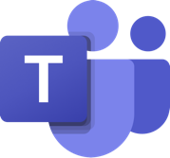

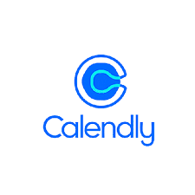







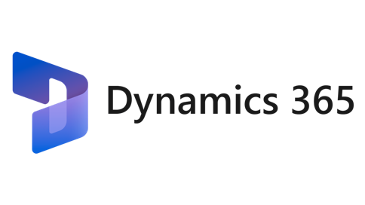





Sales domain AI agents accelerate sales processes to boost productivity
Agents
SALES ENABLEMENT
PROSPECTING SUPPORT
OPPORTUNITY MANAGEMENT
ROI
180K
hours saved weekly by account teams¹
4714
seller questions answered in first 10 weeks²
Zero
lines of code written²
18K
hours saved monthly³
40%
increase in quality of outreach content³
20%
increase in engagement opportunities³
50-70%
reduction in time spent performing tasks⁴
15%-25%
increased revenue from productivity gains⁴
25-35%
improvement in quality of output⁴
Flows
Product recommendation
Get list of seller opportunities in territory [Salesforce]
List products relevant to opportunity [ZoomInfo]
Find digital assets including demos [Seismic]
Compare product capabilities [watsonx.ai]
Summarize key selling points [watsonx.ai]
Prospect outreach
View accounts associated with seller [Salesforce]
Retrieve contacts within prospects [ZoomInfo]
Cross-verify contact details [LinkedIn Sales Nav]
Create task for new contacts [Salesloft]
Generate email content [watsonx.ai]
Email prospect [Outlook]
Client Meeting Insights
Download meeting transcript [Webex, Teams]
Summarize transcript [watsonx.ai]
Extract sentiment, action items… [watsonx.ai]
Update comments in lead record [Salesforce]
Progress opportunity stage [Salesforce]
Share with account lead [Outlook]
Apps
Notes:
The sales domain represents another strategic priority for AI-driven automation, and just like with HR, IBM has achieved exceptional return on investment (ROI) through focused deployments in sales enablement, opportunity management, and prospecting support.
This slide highlights the growing set of AI agents purpose-built for sales functions—each designed to automate high-value use cases and augment seller productivity. As illustrated at the bottom of this slide, IBM’s internal AskSales solution integrates across a wide ecosystem of sales tools and applications, including customer relationship management (CRM) platforms, pricing engines, and content libraries.
By enabling sellers to access information and execute tasks through a natural language interface, these agents reduce the administrative burden and allow sales teams to focus on client engagement and deal acceleration.
These prebuilt solutions reflect IBM’s deep understanding of sales processes and are engineered to drive measurable outcomes across the sales lifecycle.
Additional information on IBM’s prebuilt Sales domain agents is available at: https://ibm.seismic.com/Link/Content/DCWBHj6fdj9CT82Xgmp3Q47PQCQj#/?anchorId=2679d8ae-4240-45c0-9a33-a10843e3c433.
Sources:
¹ Account360 transforming collaboration across client-facing teams with watsonx, Seismic: https://ibm.seismic.com/Link/Content/DCHbh2qfQCVXq8HB429Qp7gMjBpP
² The best answers, fast and simple with AskSALES, Seismic: https://ibm.seismic.com/Link/Content/DCDB2DfhfVCm6G2M6j96Q4BFXPdd
³ Personalized Sales Content Delivery with watsonx Orchestrate, Seismic: https://ibm.seismic.com/Link/Content/DC67qXGQ9fJVBG7VhpMchfg9chmG
⁴ Creating a Digital Sales AI Assistant with watsonx Orchestrate, Seismic: https://ibm.seismic.com/Link/Content/DCpRB2QPb3PXT8cPBhcGC2fMdWDG
⁵ 174% increase in cloud sales, AI-Powered Training Platform, Oi Soluções, LinkedIn: https://www.linkedin.com/posts/oisolucoes_para-ampliar-o-conhecimento-do-time-e-garantir-activity-7143298564528525312-bieh?utm_source=share&utm_medium=member_desktop

Slide 42




Procurement agents accelerate processes & boost productivity (1/2)
Use Case
Supplier Management
Purchasing
Sourcing & Contracts
Persona(s)
Procurement Analysts & Manager
Procurement Analysts, Manager, Director; Requestors and Suppliers
Procurement Manager & Director
Outcomes
Ensure compliance and faster path to risk-mitigation
Faster and efficient resolution to operational procurement needs via self-serve queries and actions
Expedite supplier evaluations & contract management
ROI
75%
Supplier risk management
efficiency gains¹
95%+
Supplier base mapped to D&B risk & ESG scores¹
45%
reduction in
helpdesk tickets¹
50%
increased speed
to resolution¹
70%
Cycle Time Improvements¹
improved
contract
compliance¹
Supplier risk insights Agent
Financial Strength, Payment insights
ESG Insights, Scores & Ratings*
Supplier Onboarding Agent
Onboard Suppliers
Supplier Management Agent
View & Update Supplier details
RFx Agent
RFP Creation for Supplier Selection
Supplier recommendation
Draft RFP using Gen AI
Contracts Mgmt. Agent
Create / View / Modify Contracts
Agents & Tools
Purchasing Agent
Check PR, PO, GR Status
Create / Modify / View PR, PO, GR
General details
Item Details
Apps
Notes:
Procurement is another high-impact domain where AI agents are transforming how business teams operate. IBM has focused on solving a fundamental challenge: procurement data is often fragmented across multiple systems, formats, and teams—making it time-consuming for sourcing professionals and business leaders to get the insights they need.
This slide highlights IBM’s internal AskProcurement AI agents, developed through a collaboration between the IBM’s CIO office and various IBM Procurement teams. Built on watsonx Orchestrate, these agents consolidate structured and unstructured data from across the enterprise and deliver it through a conversational interface.
Users can quickly ask questions about purchase orders, sourcing pipelines, supplier spend, and contract statuses—getting real-time answers without navigating multiple systems. It even handles frequently asked questions around procurement policies using generative AI.
These agents don’t just save time, they democratize procurement insights across the business, eliminate manual steps, and ensure teams have access to accurate, timely information to drive better supplier decisions.
Additional information on IBM’s prebuilt Sales domain agents is available at: https://ibm.seismic.com/Link/Content/DCWBHj6fdj9CT82Xgmp3Q47PQCQj#/?anchorId=c640d786-e292-402f-af9c-1de9ac5f3c39. Also, in addition to the IBM client zero references on this and the following slide, seller can use the Trico Steamship Agency use case at https://www.ibm.com/case-studies/tricon-steamship-agency.
Source:
¹ IBM Procurement (IBM’s AskProcurement Client Zero implementation)
Terminology:
D&B: Dun & Bradstreet
ESG: Environmenta, social, and governance
GR: Goods receipt
PO: Purchase order
RFP: Request for proposal
PR: Purchase requisition

Slide 43


Procurement agents accelerate processes & boost productivity (2/2)
Use Case
Invoice Management
External Workforce
Procurement Insights
Persona(s)
Procurement Analysts, Manager, Director; Requestors and Suppliers
Procurement Manager, HR Manager
Procurement Manager & Director
Outcomes
Expedited and efficient invoice verification & processing
Increased productivity and efficiency of onboarding contingent labor
Accelerated supplier evaluations & contract management
ROI
88%
decrease in time to close invoices¹
90%+
Reduction on time to solve
blocked invoices¹
42k
Hours saved¹
60%
reduction in time to manage each requisition ¹
75%
improvement in forecast accuracy¹
reduced
contract
leakage¹
Invoice Mgmt. Agent
Create / View / Modify supplier invoices
Invoice status check
Blocked invoice resolution Agent
Price & Qty. variance
Overspent POs
Contractor Requisition Agent
Create position for external resource
Create / publish job requisition using GenAI
Shortlist candidates, and share profiles
Interview scheduling
Statement of work creation
Contract Spend Analysis Agent
Classify contract spend data and extract data [watsonx.ai]
Identify trends + outliers, recommend opportunities for optimization [watsonx.ai]
Category Insights Agent
Agents & Tools
Apps
Notes:
This slide continues the view into IBM’s procurement-focused domain agents. These agents are designed to support goal setting, feedback collection, and review workflows, further extending automation across the full procurement lifecycle.
Additional information on IBM’s prebuilt domain agents is available at: https://ibm.seismic.com/Link/Content/DCWBHj6fdj9CT82Xgmp3Q47PQCQj#/?anchorId=c640d786-e292-402f-af9c-1de9ac5f3c39. Also, in addition to the IBM client zero references on this and the following slide, seller can use the Trico Steamship Agency use case at https://www.ibm.com/case-studies/tricon-steamship-agency.
Source:
¹ IBM Procurement (IBM’s AskProcurement Client Zero implementation)
Terminology:
PO: Purchase order

Slide 44
Agentic AI in watsonx Orchestrate
IBM’s Unique Approach
Orchestrator for Tools and Agents
AI AgentOps
Multi-agent, multi-tool supervisor, router, and planner which facilitates complex task execution
Discover, manage, monitor & optimize autonomous AI agents
Agent Catalog and Prebuilt AI Agents
Accelerate AI Agents with pre-built utility agents and domain agents. Provide an easily searchable catalog of AI agents and tools.
Build Your Own Agents
Build custom designed agents with pro-code to no-code tooling
Integrate 3rd party agents built in any tool or framework
Notes:
The third pillar of watsonx Orchestrate empowers enterprises to build custom AI agents that are tailored to their specific needs, whether using intuitive no-code tools or advanced pro-code capabilities. It also enables seamless integration of third-party agents built on any tool or framework, ensuring flexibility, extensibility, and alignment with existing development practices.

Slide 45
Simplified & optimized agent building experience
Use existing AI agents
Use existing agents available within the enterprise
Build on best-in-class agent frameworks; plug & play external agents
Users see the chain of thought & reasoning behind the Agents and tools being called
Business users configure AI agents in no-code studio
Business teams can quickly configure AI agents
Quickly configure domain-specific AI agents by connecting them to pre-built and custom tools integrated with enterprise systems
Custom-build AI agents with simplified SDK
Technical teams can build custom-designed agents
Use the Agent Developer Kit to configure, customize & launch AI agents
Notes:
IBM watsonx Orchestrate delivers a streamlined agent-building experience tailored for both business users and technical teams.
Enterprises can start by leveraging existing AI agents within their organization or integrating third-party agents built on best-in-class frameworks, ensuring compatibility and speed to value.
For business teams, the no-code Agent Builder studio enables quick configuration of domain-specific AI agents. These agents can be connected to both prebuilt and custom tools already integrated with enterprise systems, significantly reducing setup time.
For development teams, the Agent Development Kit (ADK) is a software development kit (SDK) that provides complete command-line-level flexibility for building and deploying sophisticated AI agents with custom logic and integrations, all while adhering to enterprise-grade development practices.
Regardless of how agents are built, builders can see the chain of thought and reasoning behind the Agents and tools as they are called in the process of answering a question or executing a task.
Together, these options provide a simplified yet powerful foundation for building and scaling AI agents across the enterprise.

Slide 46
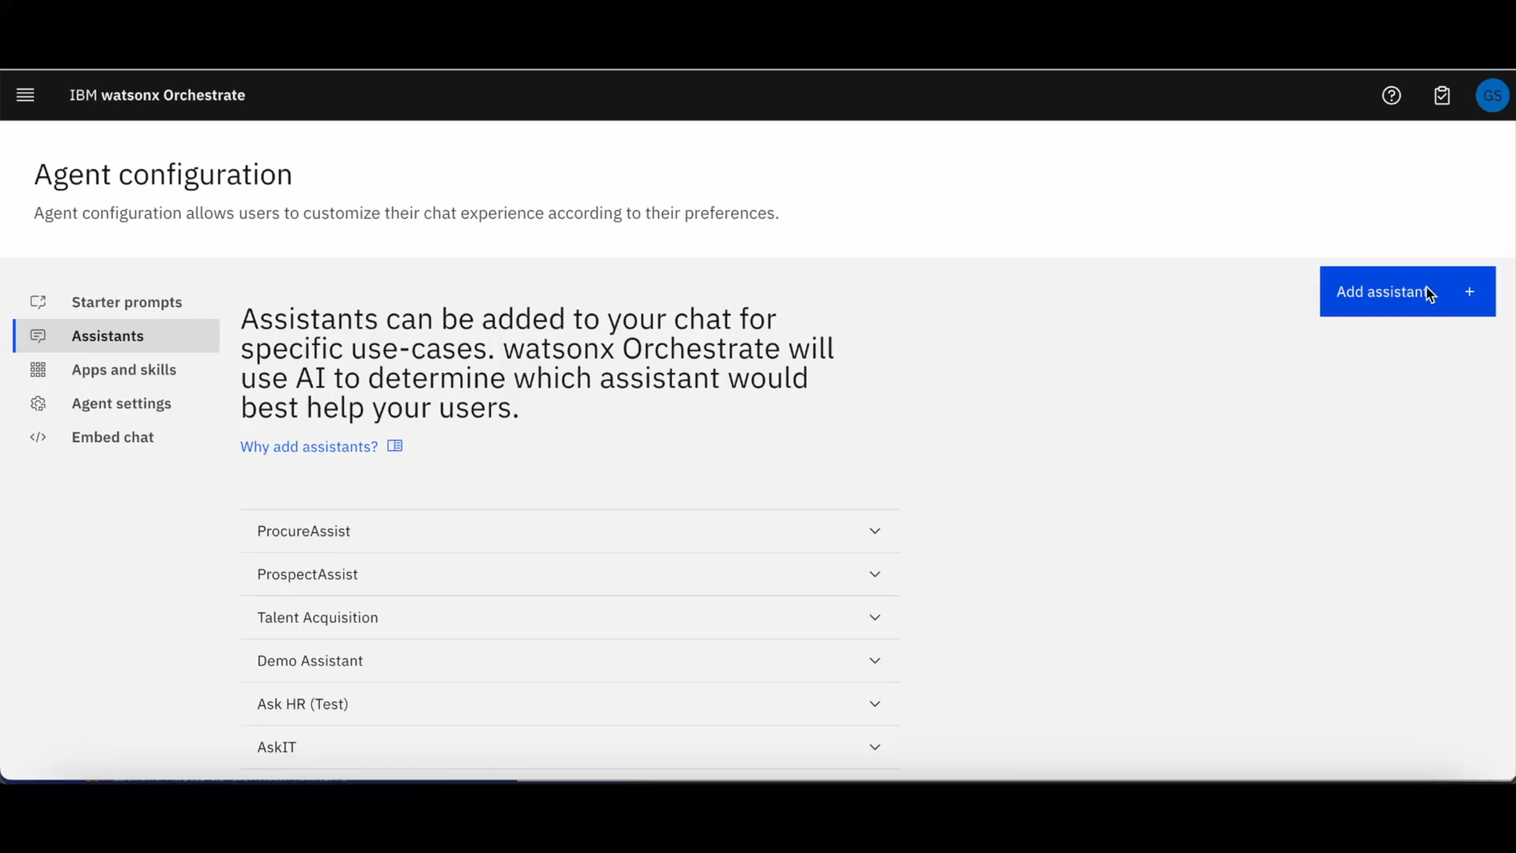
Demo Add an existing AI agent
Integrate existing agents available within the enterprise into watsonx Orchestrate
Build on best-in-class agent frameworks and plug & play (external agents)
Full video version →
Notes:
<CLICK TO PLAY DEMO>
The video on this slide demonstrates how users can add existing collaborator agents using just an API key.
Note: The video featured on this slide is a segment from the SKO1 2025 kickoff session. Sellers can view the replay starting at the 1:12 mark at the following link: https://secure.video.ibm.com/channel/26386331/video/134198951.

Slide 47
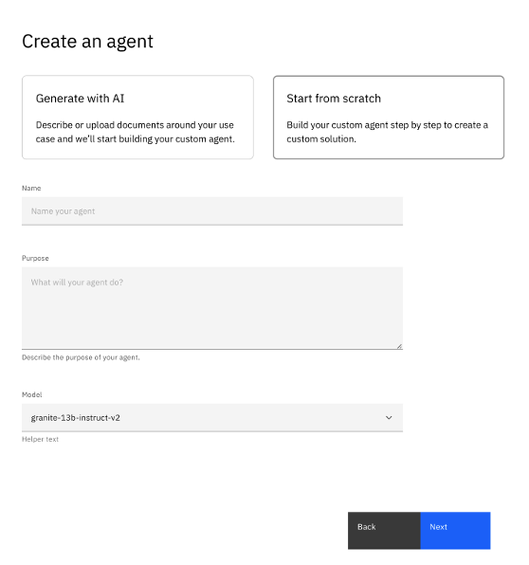
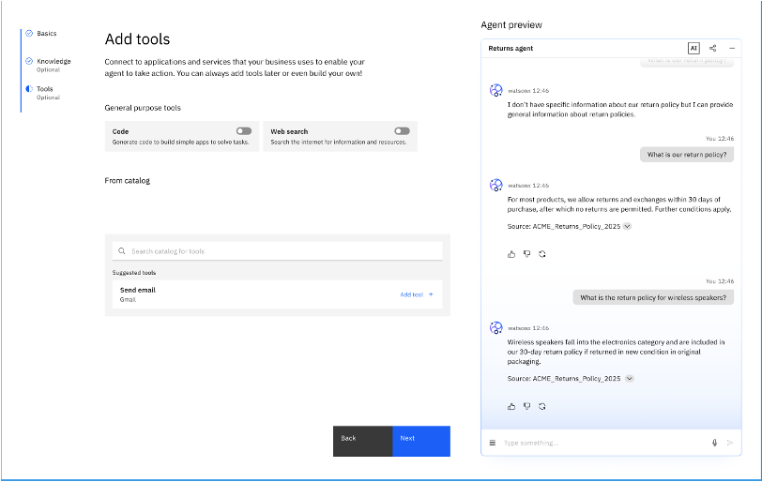
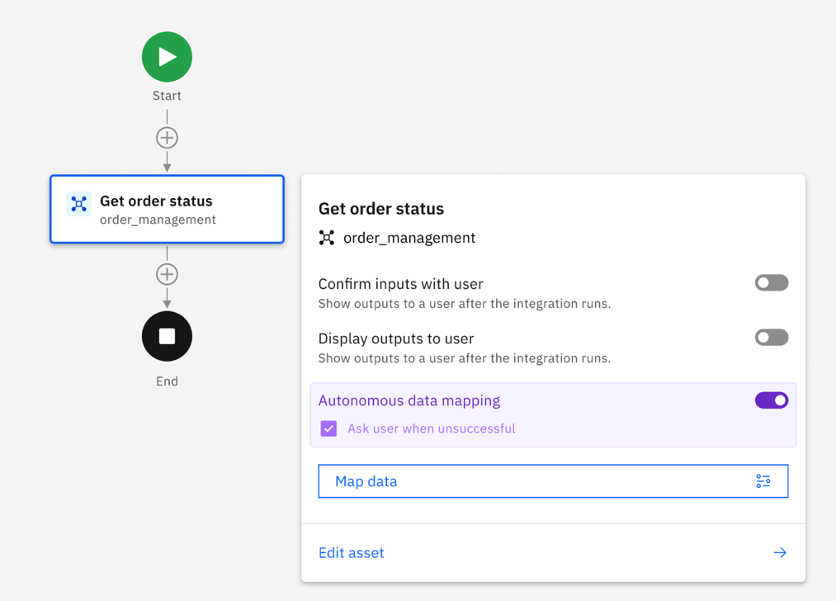
No-code AI Agent Builder
Overview
Benefits
With the no-code Agent Builder, enterprises can easily build, deploy and manage agents grounded in business knowledge and tools to act in guided flows, collaborate with other agents with the guardrails, agent-ready tools and chat customization enterprises need.
No coding or development required to build and deploy AI agents
Hundreds of pre-built tools for AI agents to carry out automations
Quick time to value for enterprises
>5min required to deploy a pre-built agent
Notes:
The No-Code Agent Builder is an integrated, end-to-end solution for building, configuring, and managing AI agents directly within watsonx Orchestrate.
Purpose-built for line-of-business (LOB) users, subject matter experts (SMEs), and knowledge workers, watsonx Orchestrate’s Agent Builder eliminates the need for development skills, making it simple to create agents grounded in business knowledge. These agents can be connected to enterprise tools, other agents, knowledge sources, and behavior guidelines, enabling them to plan, act, and reflect effectively on their tasks.
Within the builder, users can:
Add tools from the catalog or build new ones using the low-code flow editor.
Import APIs or Python code to create custom tools.
Add other agents as collaborators to build multi-agent workflows.
Sequence tools and user actions into guided flows to achieve specific business outcomes.
Support a range of scenarios, including ad-hoc tasks, single or multi-user flows, and human-in-the-loop processes like approvals or document review.
Additional features include:
Drag-and-drop support for OpenAPI docs and code snippets.
Specialized agents for runtime tasks such as data mapping.
Integrated playback and debugging tools to test and refine agent behavior.
Seamless access to advanced workflow capabilities, all within a unified agent-building experience.
Agents built using the Agent Builder can be deployed directly into AI chat interfaces and published to watsonx Orchestrate’s Agent Catalog. Lifecycle management is also included, with features such as usage analytics, status indicators, and change logs, ensuring full visibility and control across the agent experience.
This is all fully integrated into watsonx Orchestrate, offering a seamless platform experience without product fragmentation, accelerating time to value and empowering teams across the enterprise to bring sophisticated agentic logic into enterprise environments while maintaining simplicity, speed, and control.
Note: The Agent Builder consolidates and replaces the former Skill Studio, encompassing all its capabilities related to skill flows, skill-based workflows, and decision logic. It will also supersede Action flows built in the AI Assistant Builder, enabling users to design deterministic flows that guide agents in executing a precise sequence of tools—bringing all these functionalities into a unified, modern agent-building experience.

Slide 48
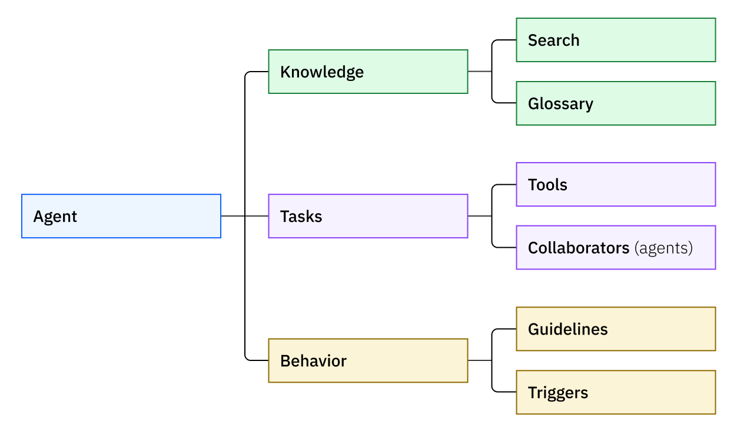
Building an AI agent in watsonx Orchestrate
An AI Agent uses tools and other agents to plan and act, while reflecting on the result
The agent orchestrator is a multi-agent, multi-tool supervisor, router, and planner, facilitating complex task execution
An AI Agent can be consumed through a conversational interface or embedded in an end-user application.
Notes:
This slide outlines the core elements involved in building an AI agent within watsonx Orchestrate.
Each AI agent is designed to plan and act by leveraging tools and collaborating with other agents. Agents run tasks while drawing on enterprise-grounded knowledge, such as internal data and documents, adhering to defined behavior guidelines. Agents also reflect on results and iteratively refine their output to meet specific objectives.
At the center of it all is the agent orchestrator—a multi-agent, multi-tool supervisor, router, and planner. It intelligently coordinates agents and tools to manage and execute complex workflows across domains.
Once deployed, AI agents can be accessed through conversational interfaces or embedded into enterprise applications, providing flexible integration into existing business environments.

Slide 49
AI Agent Example: Sales Prospecting Agent
Name
Sales Prospecting Agent
Purpose
You help sales reps prospect for new deals and have knowledge about sales operations and products.
The agent purpose defines the personality and role the agent should play.
Tasks
Tools
Web search
Each agent can have zero or more tools for direct use.
Collaborators
Research agent
CRM agent
Digital sales assistant
Each agent can collaborate with other agents. The orchestration engine decides how to delegate tasks to collaborators and synthesize responses to the user.
Knowledge
Search
Sales prospecting best practices
Sales enablement repository
Search content grounds the agent.
Glossary
Term: CRM
Definition: The Customer Relationship Management system where accounts are managed
Synonyms: Salesforce, Sales Cloud
Glossary terms help the agent understand and navigate its domain.
Behavior
Guidelines
When: user asks to update CRM data
Then: always suggest input fields and confirm with the user before updating the CRM
Task: CRM tool
Guidelines help ensure consistent behavior across all interactions.
Triggers
Triggers are events that agents respond to asynchronously.
Notes:
This slide illustrates how the various components of an AI agent work together. It uses a Sales Prospecting Agent as an example.
Purpose: Every agent starts with a clear purpose that defines its role and personality. In this case, the sales prospecting agent is designed to identify, qualify, and engage potential leads, acting as an intelligent assistant to sales teams.
Tools: Agents can be equipped with tools that enable them to take action. For this sales prospecting agent, this might include a tool that queries a company database, performs a LinkedIn search, or runs a prospect qualification workflow.
Collaborators: Agents don’t work in isolation. An orchestration engine allows them to call on other agents as collaborators. For example, the sales prospecting agent might trigger a Research Agent to gather firmographic data or engage a customer relationship management (CRM) Agent to retrieve account history.
Search: Agents can be grounded in a company’s structured and unstructured content. A sales agent might be connected to a sales enablement repository to answer questions about products, playbooks, or value propositions.
Glossary: Every organization has unique terminology. A glossary ensures the agent understands key phrases, like “TAM” (which stands for Total Addressable Market) or specific product code names.
Guidelines: These define how the agent behaves across conversations and ensure compliance with company policies. For example, the sales prospecting agent may be required to disclose data usage terms when interacting with leads or to avoid making pricing commitments to adhere to corporate governance and legal standards.
Triggers: Agents can respond to events asynchronously. For instance, if a new lead is added to the CRM, the sales prospecting agent could automatically begin research and prepare a personalized outreach email.
Each of these elements contributes to the agent’s ability to act with context, precision, and enterprise relevance.

Slide 50
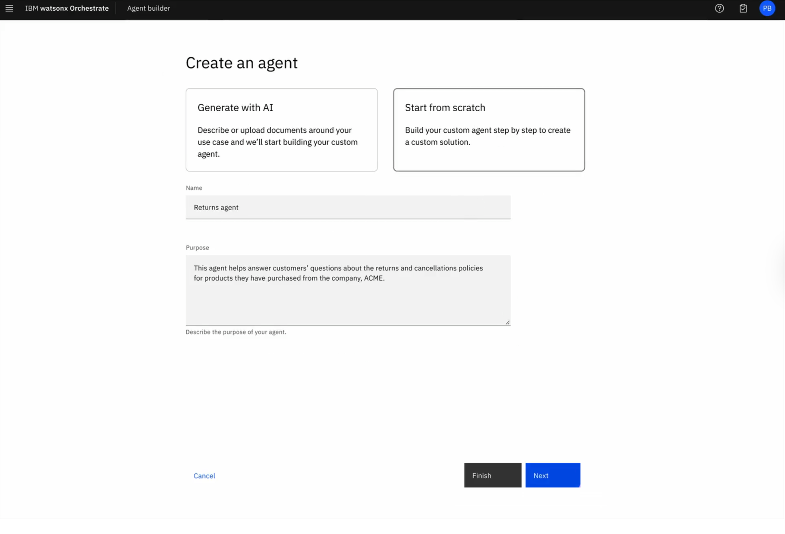
Agent Builder Studio
A no-code agent & tool builder studio that unifies watsonx Orchestrate builder capabilities into a single, simplified experience
Experience the product walk-through here →
Notes:
To explore the capabilities of the no-code Agent Builder in action, sellers can access an interactive, click-through demo using the link on this slide. This walkthrough provides a hands-on experience on how to build, configure, and deploy AI agents using the Agent Builder.
This click-through demo is a great way to become familiar with watsonx Orchestrate’s interface, its features, and the workflow associated with creating agents—especially useful for sellers and internal teams looking to showcase the value of watsonx Orchestrate.
Sellers can access this demo at: https://w3.ibm.com/learning/watsonx-orchestrate-demo. (Accessible to IBMers only at this time.)

Slide 51
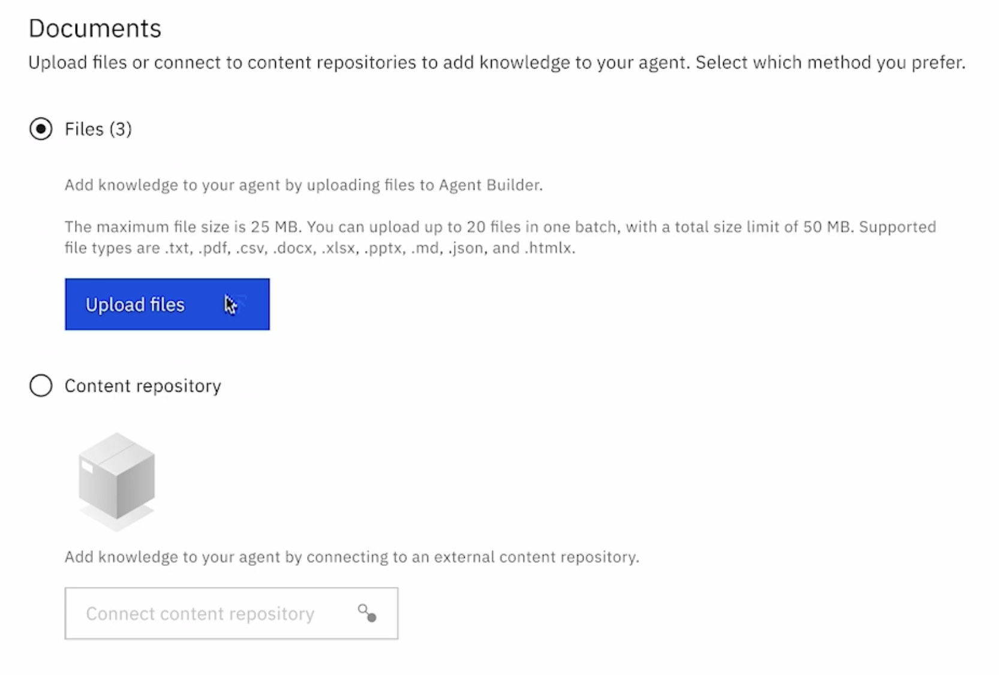
Gain real value from existing content repositories
Knowledge
Best-in-class retrieval-augmented generation (RAG)
Prebuilt integration to vector database & semantic search
Embedded watsonx.ai LLMs
Upload documents directly to your agent
Trace and verify answers to their specific sources
Notes:
One of the most powerful features in watsonx Orchestrate is the ability to connect agents to enterprise knowledge through Retrieval-Augmented Generation (RAG). This architecture enables agents to answer questions grounded in a company’s own business content accurately, securely, and transparently.
With RAG, the system retrieves relevant information from enterprise data—like benefits documents, policies, or manuals—then uses a large language model to generate a conversational answer. The beauty of this approach is that it keeps the information up to date, traceable, and aligned with an enterprise’s knowledge. If the answer can’t be found, the agent can simply say “I don’t know,” rather than risk hallucinating incorrect responses.
This is where IBM truly stands out. Unlike many vendors who rely on internet-scale data, which requires heavy refinement for enterprise use, IBM’s approach is enterprise-native. The vector database integration, semantic search, and document chunking are all prebuilt—no custom code or prompt engineering required. Builders can upload content in multiple formats, and the platform automatically handles indexing.
The RAG approach is powered by watsonx.ai, including IBM’s Granite models, ensuring enterprise-grade trust, transparency, and accuracy. And it works at scale: in one deployment, a client with over 300 million documents achieved more than 80% accuracy in conversational search —a notable industry-leading result.
This is how IBM helps organizations turn their own data into a competitive advantage, with trustworthy, explainable AI right out-of-the-box (OOTB).
Definitions:
Chunking: The procedure of dividing extensive documents or datasets into smaller, more manageable parts (chunks), typically determined by sentence boundaries, paragraphs, or semantic meaning. This approach guarantees a more relevant and efficient retrieval of information when searching through a vast knowledge base.
Indexing: The method of structuring and organizing the chunked data so that it can be efficiently searched and retrieved. This typically involves using vector embeddings and storing them in a vector database, allowing the RAG model to quickly find the most relevant chunks when generating responses.

Slide 52
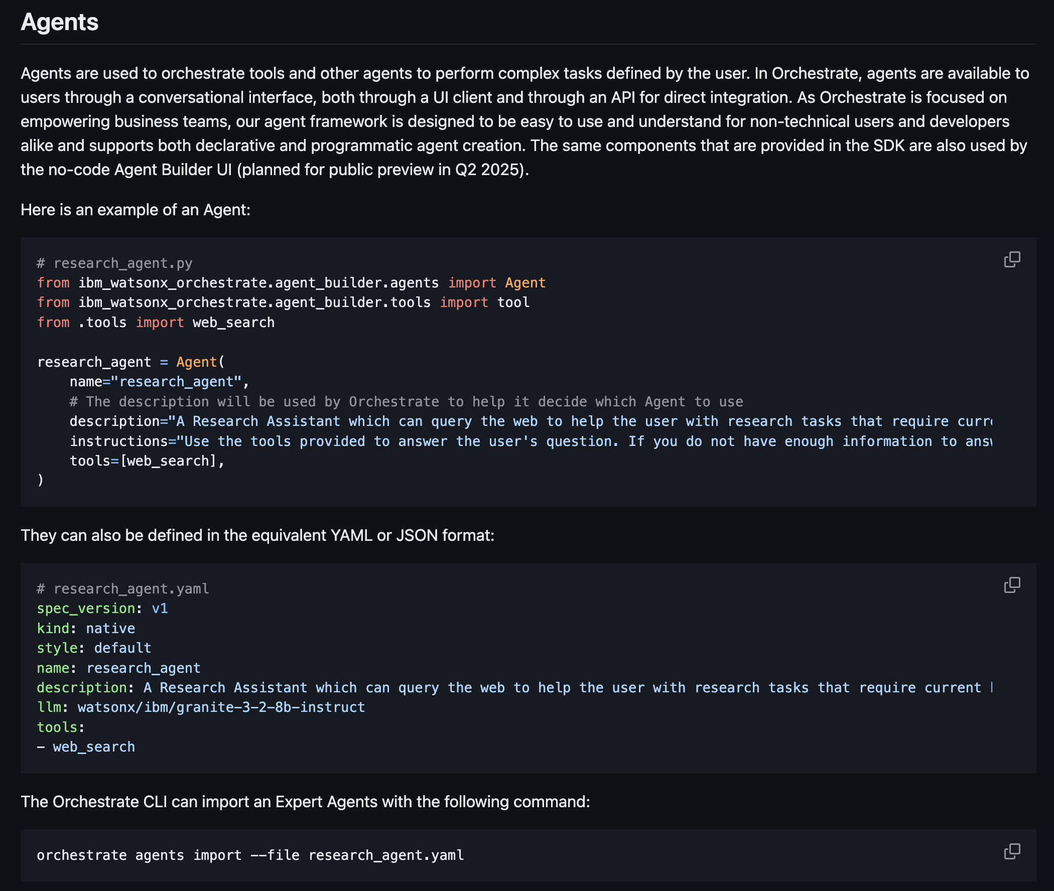
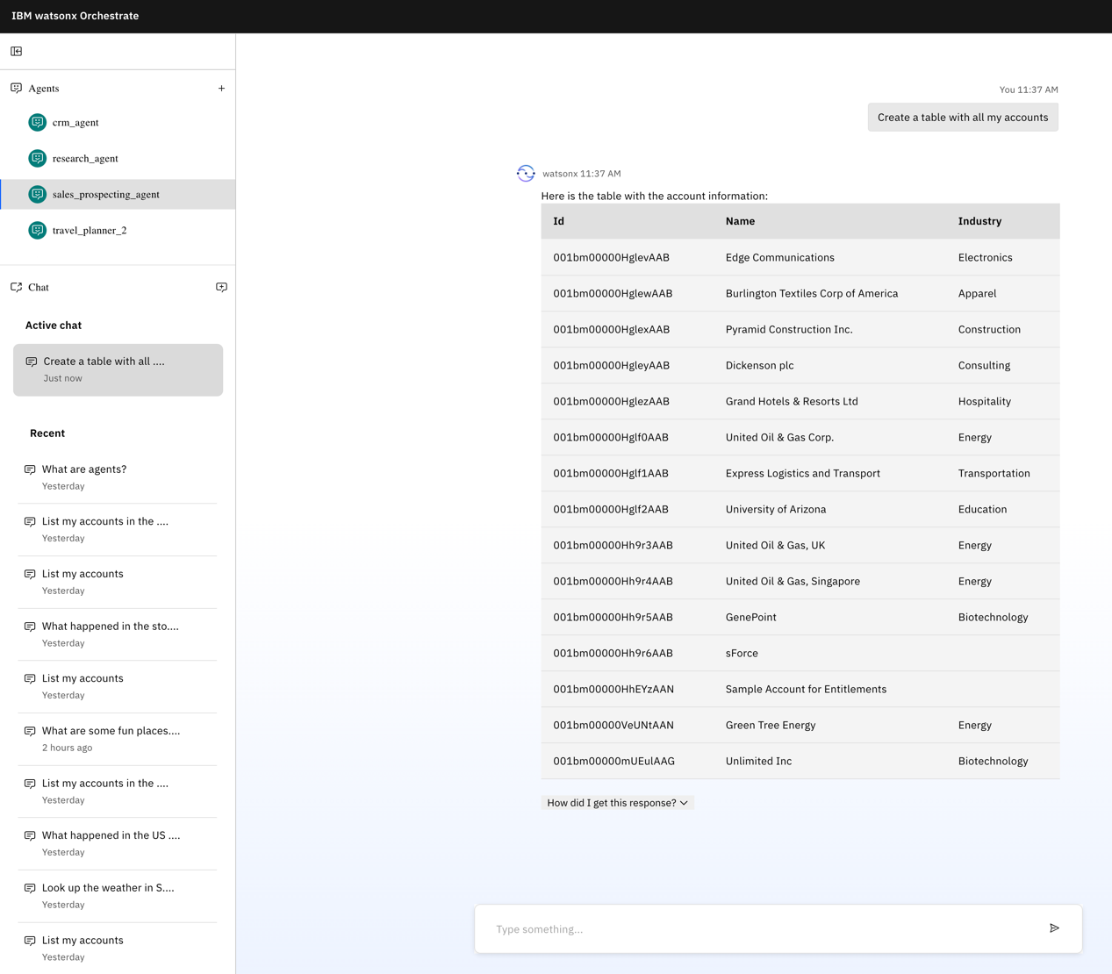
Agent Development Kit
Overview
Benefits
With the Agent Development Kit, enterprise and development teams can build expert agents from scratch, standing up a local development platform and server where they can build agents and tools, and deploy them directly to watsonx Orchestrate.
Simplified development with everything needed to build agents and tools in a single kit
Streamlined integration with other platforms and services
Build, test and deploy easily from a local environment
Notes:
While watsonx Orchestrate prioritizes accessibility through no-code experiences, IBM also fully supports deep development use cases with the Agent Development Kit (ADK). The ADK is a comprehensive toolkit that empowers enterprise and development teams to build highly specialized AI agents and tools from scratch. Developers can stand up a local development platform and server on their laptops, enabling them to build, test, and deploy agents directly into watsonx Orchestrate with full support for CI/CD and GitOps workflows, making it ideal for teams practicing modern DevOps.
Built for flexibility and power, the ADK provides everything needed in a single kit, making it easy to:
Develop agents with fine-grained control over logic, data handling, and behavior
Build and integrate custom tools using Python or OpenAPI specifications
Streamline integration with external platforms and services
Use local dev environments to prototype, iterate, and deploy confidently
Seamlessly plug into enterprise-grade DevOps pipelines
The ADK is open-source, giving teams the freedom to adapt and extend it to meet their unique needs.
With the ADK, IBM ensures that both no-code users and professional developers are fully equipped to succeed in building enterprise-ready AI agents. Furthermore, agents & tools built with ADK and the Agent Builder can work together seamlessly in the same instance, providing the ability for business and technical users to collaborate during the build process.
Definitions:
DevOps: A set of practices that integrates software development and IT operations to shorten the development lifecycle and deliver high-quality software continuously.
CI/CD (Continuous Integration/Continuous Delivery): A development approach that automates the integration, testing, and deployment of code changes to ensure rapid and reliable software delivery.
GitOps: A software development and operations model that uses Git as the single source of truth to declaratively manage and automate infrastructure and application deployments.

Slide 53
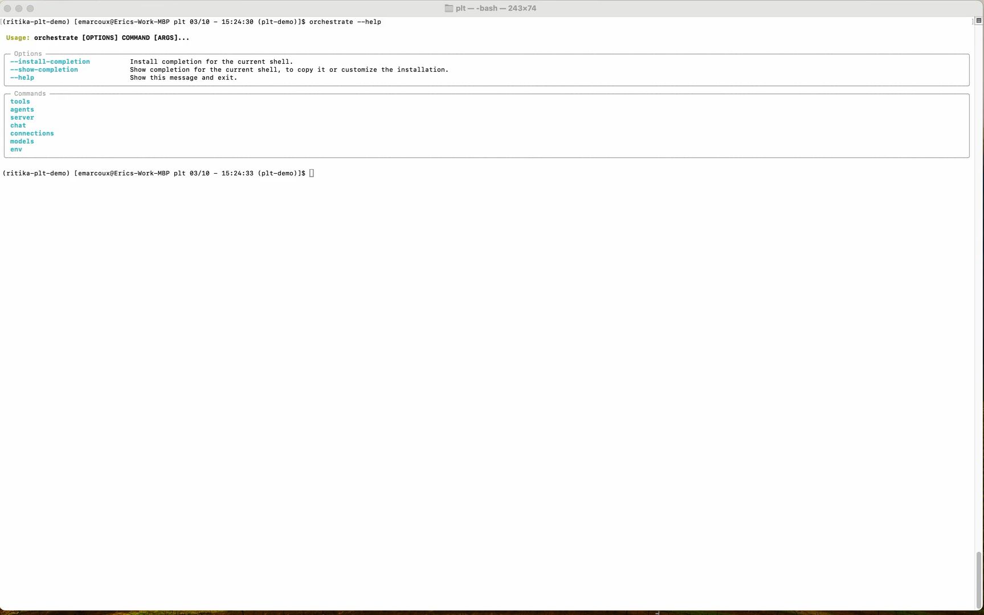
ADK Demo
Simplified development with everything needed to build agents and tools in a single kit
Streamlined integration with other platforms and services
Build, test, and deploy easily from a local environment
Notes:
This demo illustrates how developers can use the Agent Development Kit (ADK) to build and test AI agents and tools directly from a local development environment. The video walks through the process of building a healthcare scenario agent from scratch using Python, importing it into watsonx Orchestrate, and testing the agent in a live chat interface. This example demonstrates the flexibility and control that technical teams can achieve when utilizing the ADK to create highly customized, production-ready agents.
Sellers can view the video with sound or narrate it using the script below.
<CLICK PLAY>
[0:00 – 0:35] Introduction
In this demonstration, you’ll see how developers, whether low-code or pro-code, can build custom tools and AI agents directly from their laptop using the watsonx Orchestrate Agent Development Kit. These agents can then be imported into a SaaS or IBM Cloud Pak for Data instance of watsonx Orchestrate.
In the command-line prompt, we will begin by typing “orchestrate env list”, after which the ADK will list the available environments.
[0:35 – 1:05] Choosing a local environment
The Agent Development Kit makes it easy to switch between environments. In this case, we select a local runtime called “dev-conn”, allowing development and testing without needing a cloud connection.
[1:05 – 2:03] Building a tool in VS Code
Let’s build a hypothetical use case: a customer care scenario for a healthcare institute. Using Visual Studio Code, we define a new tool: “Search Healthcare Providers.” A simple “@tool” tag registers the tool, while rich metadata like function descriptions and input/output types help the large language model (LLM) understand what it does. Here, we’re using the “Requests” library to fetch provider information.
[2:03 – 2:56] Importing the tool
Next, we import the tool into the local watsonx Orchestrate runtime using the command-line interface, specifically the command “orchestrate tools import”, specifying the Python script and any dependencies in the “requirements.txt” file. It’s that easy to make new capabilities available to agents.
[2:56 – 3:40] Creating the agent
Now, we tie this tool to a new AI agent. Here, we define a “Customer Care Agent” with a clear purpose, a set of tools it can use, including our new healthcare search, and collaboration links to other agents, like a ServiceNow assistant. This is where orchestration begins, as it involves assembling skills, tools, and other agents to tackle real tasks.
[3:40 – 4:26] Importing the agent
Just like with tools, we import the agent with a single command, specifically the “orchestrate agents import” command. The command-line interface handles the registration and integration process so the agent is ready to go.
Now, we will spin up a local user interface using the “orchestrate chat start” command and begin chatting with our new agent. The developer interface offers a clean and efficient way to test and iterate locally before deployment.
[4:21 – 6:30] Testing the agent in local chat and demonstrating the agent’s capabilities
The agent is now live and ready to support customer service tasks. It can handle queries, reach out to collaborators, and take actions, like searching for a provider, all using natural language. You’ll notice how fast and fluid the experience is thanks to the orchestration layer.
[6:40 – 7:16] Wrap-up
With the Agent Development Kit, developers can rapidly build, test, and deploy expert-level agents and tools, all grounded in business logic, running on a local environment, and seamlessly deployable to production. It’s flexibility, speed, and power—built for enterprise AI.

Slide 54
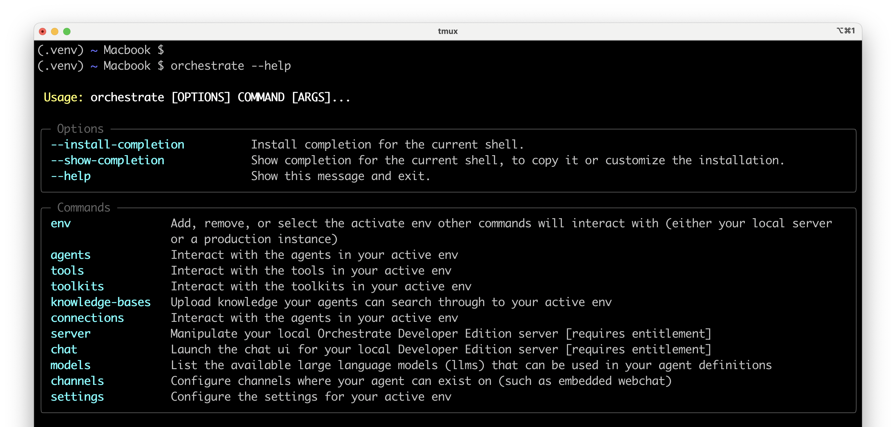
4 steps to set up an agent with the ADK
Set up a local copy of the watsonx Orchestrate runtime
Build & edit your agent & tool definitions
Import them into the local server
Preview to test agents, collaborators & tools in real time
Options
Commands
Installation guide →
Documentation →
Notes:
To recap the Agent Developer Kit (ADK) demo on the previous slide, there are four steps for developers to set up an AI agent using the watsonx Orchestrate ADK. First, set up a local instance of the runtime. Then, define and build the agent and its tools using Python or OpenAPI. Once ready, import them into the local server, and finally, test the agent interactively in real time using the built-in preview interface.
This gives developers full control over the design, testing, and behavior of their agents before deploying to production. On this slide, sellers will also find links to the ADK documentation and installation guide, which make it easy to get started.
Links:
ADK installation guide: https://github.ibm.com/WatsonOrchestrate/wxo-clients/wiki/Agent-Builder-SDK-Orchestrate-Laptop-Installation-Guide
ADK documentation: https://developer.watson-orchestrate.ibm.com

Slide 55
Areas of AI Agent Innovation
Orchestrator for Tools and Agents
AI AgentOps
Multi-agent, multi-tool supervisor, router, and planner which facilitates complex task execution
Discover, manage, monitor & optimize autonomous AI agents
Agent Catalog and Prebuilt AI Agents
Accelerate AI Agents with pre-built utility agents and domain agents. Provide an easily searchable catalog of AI agents and tools.
Build Your Own Agents
Build custom designed agents with pro-code to no-code tooling
Integrate 3rd party agents built in any tool or framework
Notes:
This next section focuses on a critical part of scaling AI agents in enterprise environments—AI AgentOps. As organizations deploy more agents across departments and business processes, they need robust capabilities to monitor, manage, and optimize performance. AgentOps addresses these needs head-on by delivering enterprise-grade observability, transparency, and traceability of agent actions. It also enables failure detection, and provides alerts, governance controls, and configuration options to ensure agents remain compliant, responsive, and aligned to business objectives.
The following slides take a closer look at how AgentOps supports sustainable and scalable AI deployment.

Slide 56
AgentOps
With AgentOps, developers can access models, tools, frameworks & governance capabilities to manage the complete AI agent development lifecycle
Build in an Open Studio
Access 3rd party models through the Model Gateway, open-source or Granite models
Utilize tools & frameworks such as CrewAI & LlamaIndex
Experiment in LangFlow’s playground environment to validate use cases before moving to production
Simplified Deployment
Reduce deployment times from hours to seconds with a one-click UI deployment or using a single command line
Optimize with your data
Utilize open source, enterprise and/or synthetic data to train an agent & ground them with vectorized data for RAG use cases
End-to-end management
Build with added tracing and observability into your Agents across the development process. This helps to:
Optimize performance
Lower costs
Monitor agent behavior to ensure ethical, trusted & regulated responses
AgentOps FAQs →
Notes:
AgentOps transforms watsonx.ai and watsonx Orchestrate into a comprehensive studio for AI agent lifecycle management, covering everything from development to governance. It brings together the tools, models, and frameworks that developers and enterprises need to build, deploy, and optimize agents at scale.
There are four key elements of IBM AgentOps:
Build in an open studio. Developers can work with IBM Granite models or 3rd-party foundation models using the Model Gateway. Popular agent frameworks like CrewAI and LlamaIndex are supported, and developers can quickly prototype agent logic in LangFlow before moving to production.
Simplified deployment. Deployment is streamlined with a one-click user interface (UI) or a single command-line interface (CLI) command, reducing deployment times from hours to seconds.
Optimize with your data. AgentOps enables training and grounding with open source, enterprise, or synthetic data—including integration with vectorized retrieval-augmented generation (RAG) pipelines for domain-specific knowledge.
End-to-end management. Agents can be built with embedded tracing and observability, allowing developers to monitor behavior, reduce costs, and ensure trustworthy and compliant interactions.
AgentOps gives IBM clients and partners an enterprise-grade framework for scaling AI agents with confidence, security, and speed.
More information is available in the AgentOps FAQs on Seismic at https://ibm.seismic.com/Link/Content/DC3T43CF83dhMGFVfCq2Mcq6gPj3.
Definitions:
LangFlow: A visual development environment for building and testing large language model (LLM) applications using a drag-and-drop interface to orchestrate prompts, tools, and data flows.
CrewAI: An open-source framework for creating and coordinating collaborative AI agents that work together to complete tasks based on defined roles and responsibilities.
LlamaIndex: A data framework that connects LLMs to external data sources by indexing and enabling efficient retrieval of structured and unstructured enterprise content.
Retrieval-Augmented Generation (RAG): An AI architecture that combines document retrieval with generative models to produce accurate, grounded responses using relevant context from external or enterprise data.

Slide 57
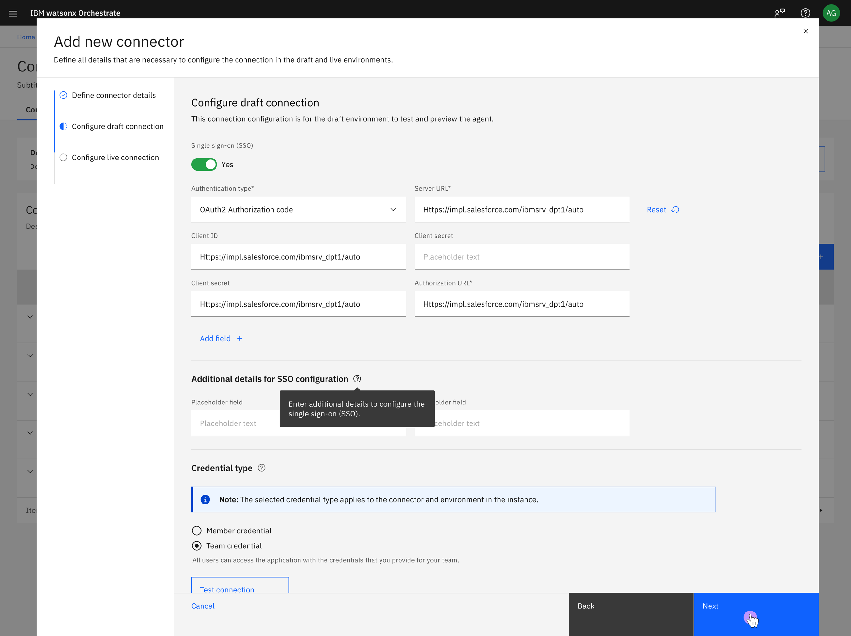
Agent security
Build trust in AI agents with secure deployments & tight security integrations
Documentation →
Notes:
To meet enterprise standards, AI agents must be tightly integrated into business systems, data environments, and operational workflows—demanding rigorous security considerations. Secure deployments require robust management of authentication protocols, consistent and optimized data handling between tools, inventory tracking of generative AI assets, and proactive monitoring for vulnerabilities and threats.
A common challenge in enterprise AI development is securely managing authentication, transmitting data between APIs and agents with integrity, and ensuring that tools are invoked consistently while keeping credentials protected.
Additionally, AI agents represent an extension of enterprise employees and must operate under strict security controls. Agents built in watsonx Orchestrate support enterprise-grade security through integration with identity providers (IDPs), enabling seamless single sign-on (SSO) authentication and trusted execution across systems.

Slide 58
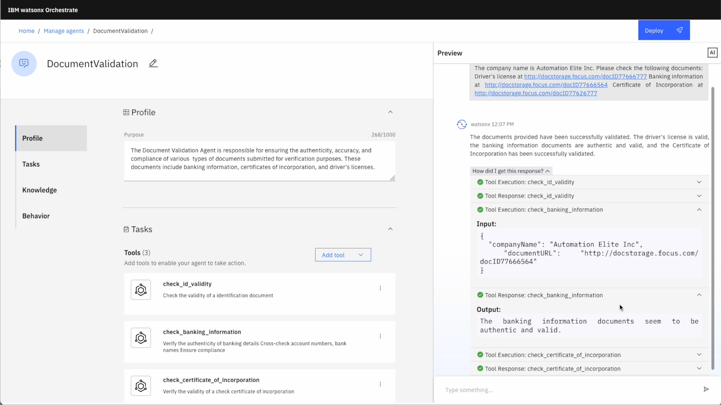

Agent testing
Ensure agent reliability, safety & accountability before deployment
Notes:
To ensure an AI agent is ready for production, developers must rigorously evaluate agent performance against defined benchmarks throughout the development lifecycle. This includes validating the impact of ongoing changes and determining whether the agent meets the required criteria to advance beyond the candidate stage.
Production-grade agents must account for orchestration complexity, including robust error handling and support for “human-in-the-loop” workflows—especially when executing high-risk actions or tasks requiring approval. Reflection mechanisms and rollback capabilities are also critical to maintain guardrails around agent autonomy and prevent unintended behavior.
Finally, every decision made by an agent must be explainable, ensuring transparency and accountability aligned with enterprise governance requirements.
The screenshot shows how a builder can preview the agent’s responses, routing, and reasoning while they are developing it.

Slide 59
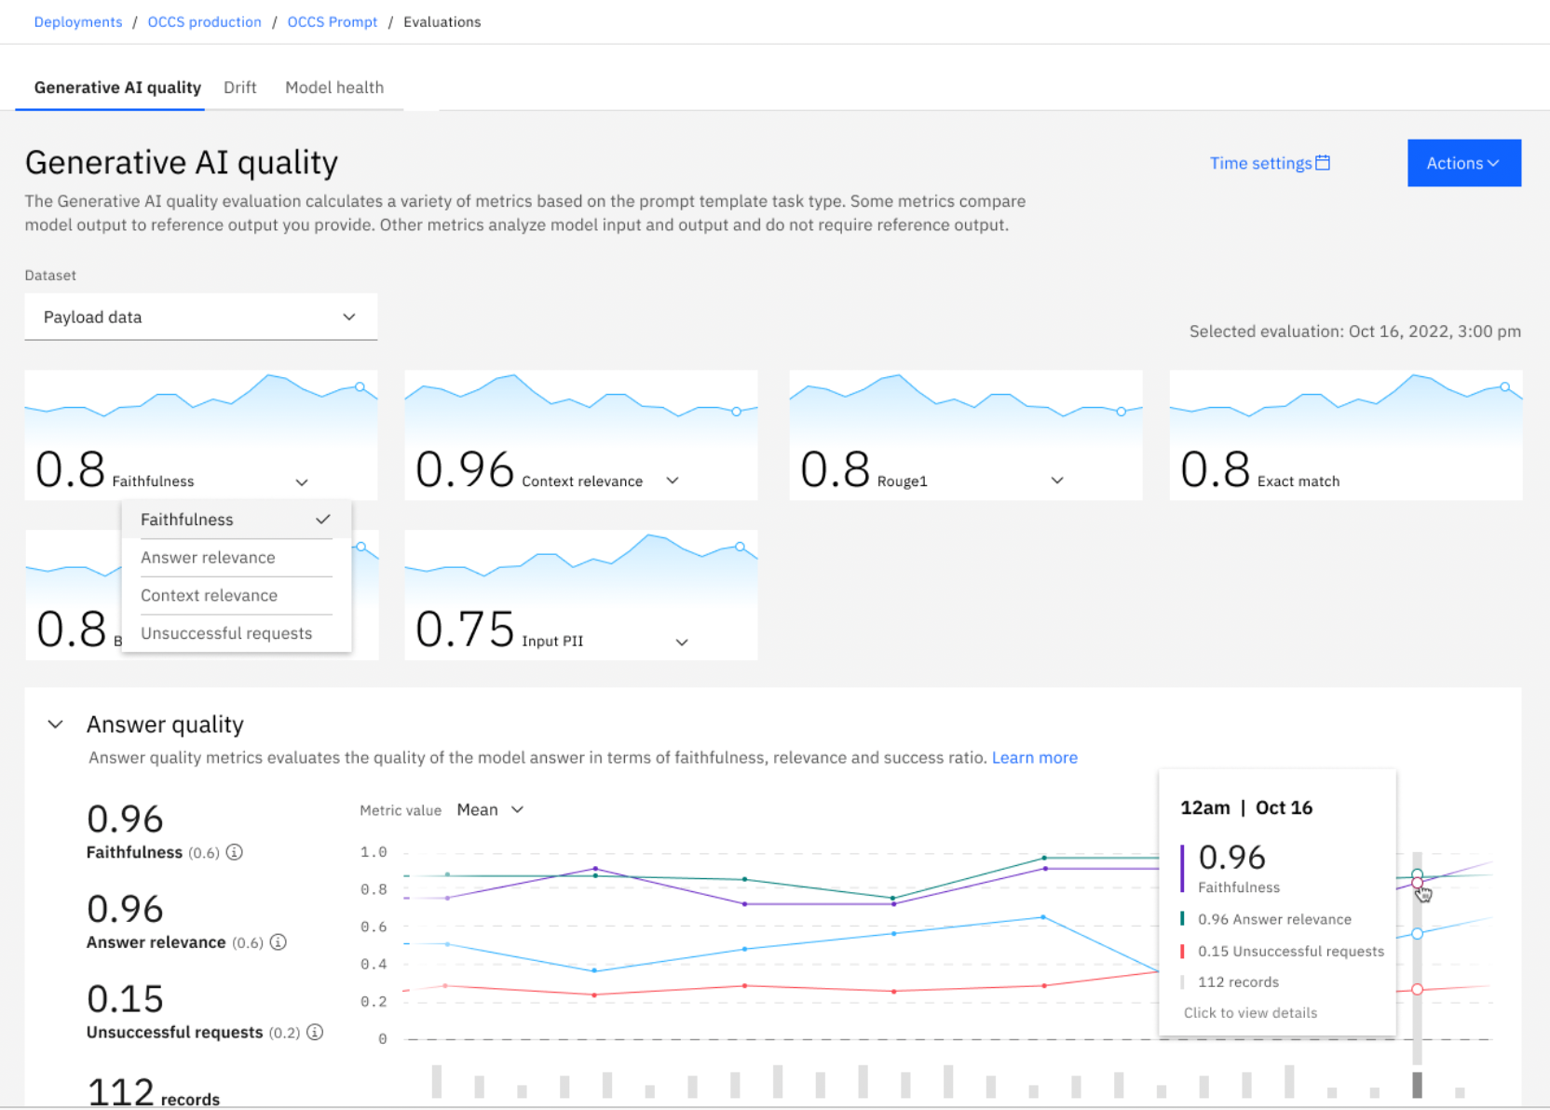
Tool response quality analysis
Evaluate & improve tool response quality using detailed GenAI metrics like faithfulness, relevance & success ratio, while monitoring for performance drift and model health
Notes:
This slide introduces how builders can evaluate tool and model performance within watsonx Orchestrate using a quality analysis dashboard tailored for Generative AI. Metrics include:
Faithfulness, which assesses whether the model’s response is grounded in the provided source data and avoids hallucinations.
Relevance, measuring how well the response aligns with the user’s intent.
Success Ratio, indicating how often the model completes the task as expected.
Drift, the gradual decline in model performance over time due to changes in data patterns, user behavior, or external conditions that differ from what the model was originally trained on.
Some of these metrics, like faithfulness and relevance, compare model output to a known reference output. Others, like success ratio, operate independently of reference data and help identify performance issues such as drift or degradation over time. This kind of observability ensures higher confidence in AI behavior before agents are deployed in production.

Slide 60
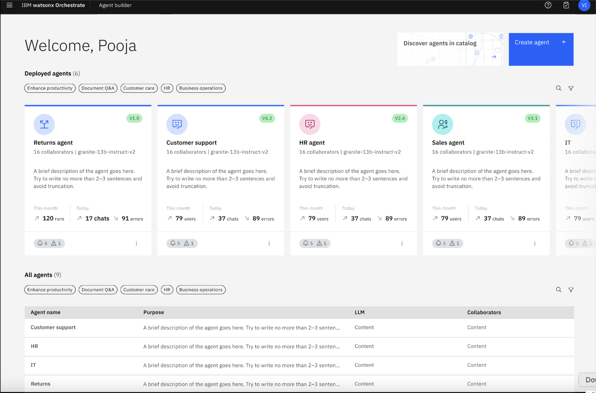
Agent monitoring
Monitor & manage large numbers of AI agents at scale with centralized visibility into agent purpose, collaboration patterns, usage metrics & operational alerts
Notes:
As organizations expand their use of AI agents, they often find themselves managing dozens, if not hundreds or thousands, of deployed agents across business units and geographies. This scale introduces new challenges around visibility, governance, and control.
Enterprises need to know:
What each agent does
How many collaborators it interacts with
How often is it’s being used
Whether it’s functioning correctly and securely
The Agent Builder in watsonx Orchestrate addresses this need by offering a unified interface for managing all deployed agents. It provides essential metadata on each agent, including descriptions, collaborators, and performance data, such as the number of monthly runs and chats, as well as real-time monitoring for errors, alerts, and warnings.
Just as importantly, this entire framework is integrated with enterprise identity providers (IDPs), ensuring secure authentication and authorization for agent tasks, crucial as agents begin to mirror employee roles and take actions on behalf of the enterprise.
This centralized observability is what transforms AI agents from one-off experiments into manageable, enterprise-grade digital labor.

Slide 61
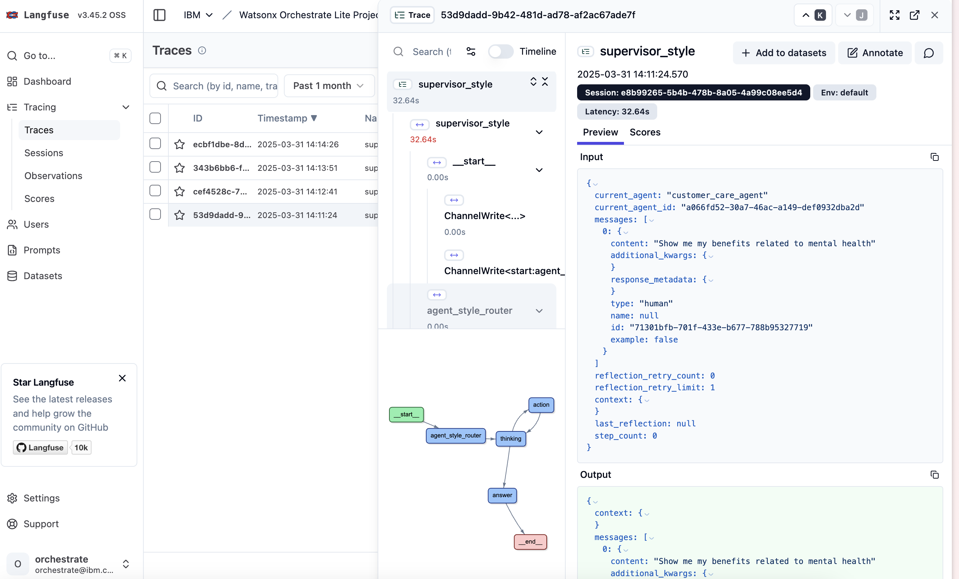
Agent debugging
Fix errors, understand agent behavior, trace decision-making & ensure responsible outcomes
Documentation →
Notes:
As AI agents grow in complexity, debugging becomes critical, not just to fix errors, but to understand agent behavior, trace decision-making, and ensure responsible outcomes. That’s where Langfuse comes in.
Langfuse is an open-source observability platform purpose-built for AI applications to which watsonx Orchestrate provides native integration, giving developers powerful insight into how agents perform across every stage of the execution flow.
With Langfuse, developers can:
Trace prompts and tool executions
View end-to-end call chains across agents, tools, and LLM interactions
Diagnose failure points, latency, and unexpected results
Monitor metrics like prompt duration, token usage, and retries
This level of transparency is essential for debugging and refining agent behavior, especially when orchestrating across multiple agents and tools.
By integrating Langfuse into watsonx Orchestrate, IBM empowers developers to move beyond black-box execution and gain full observability into agent reasoning and task execution. It’s a key part of IBM’s AgentOps capability and it sets the foundation for reliable, trusted, and high-performing AI agents in production.

Slide 62
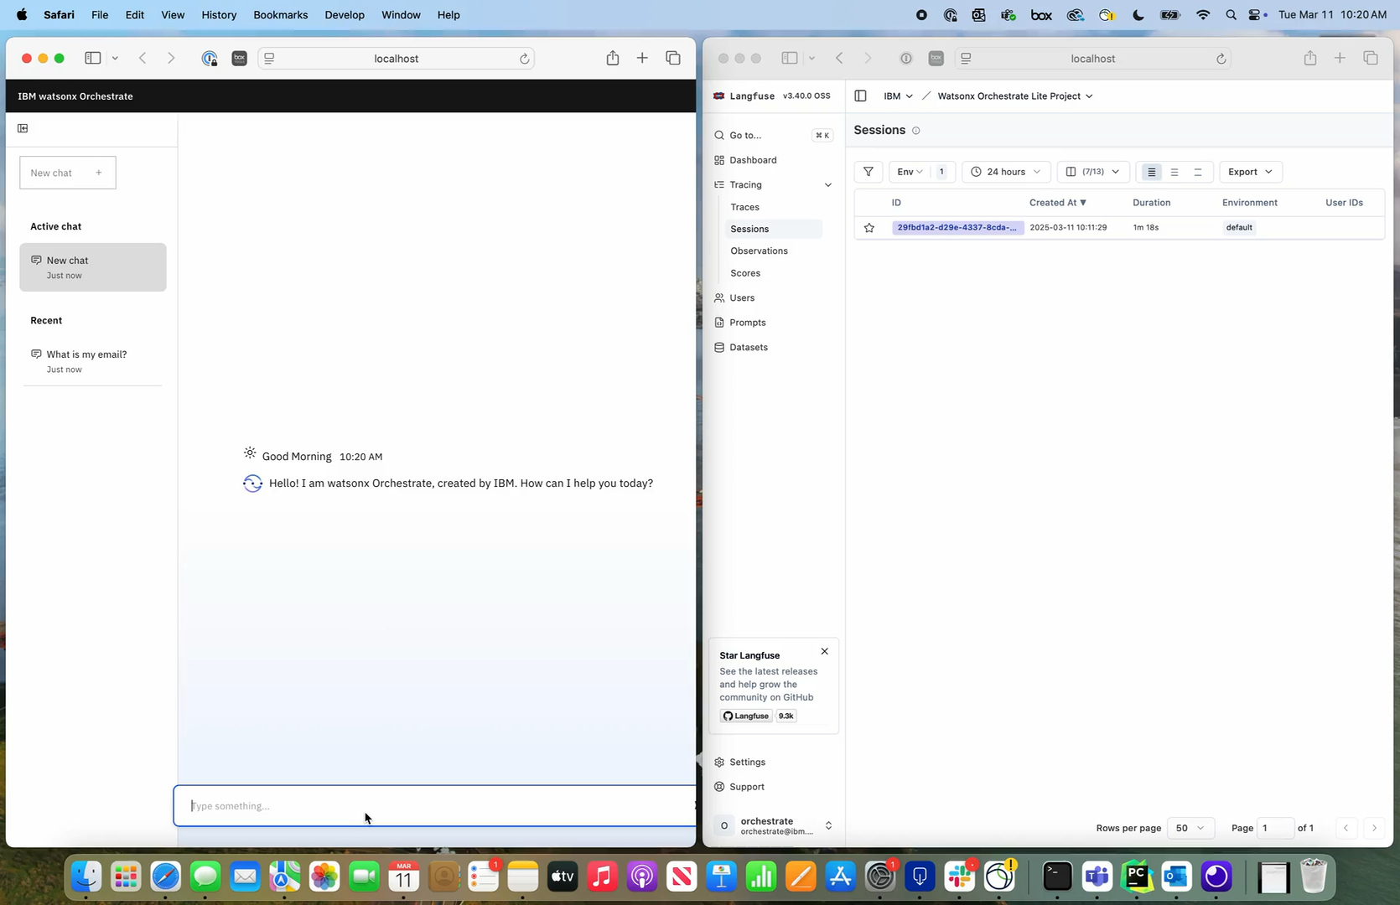
Demo:
Visualize the complete, end-to-end operation of AI agents in real-time
Documentation →
Notes:
<CLICK PLAY>
This slide features a short demo that highlights watsonx Orchestrate’s native integration with Langfuse, a powerful open-source observability framework.
Langfuse enables enterprise teams to visualize the complete, end-to-end operation of AI agents in real-time. This demo provides a side-by-side view of watsonx Orchestrate and Langfuse, where Langfuse captures and traces the full execution flow, from the initial user prompt through each step the agent takes, to the tools and collaborator agents invoked in the background to generate a complete response.
This level of transparency is crucial in complex environments, where AI agents need to act autonomously while still being governed, monitored, and audited. Langfuse makes it easier to identify bottlenecks, debug performance issues, and ensure that agent behavior aligns with enterprise expectations, making it an essential part of watsonx Orchestrate’s AgentOps capabilities.

Slide 63
$3.5 billion over 2 years in enterprise productivity gains with AI Assistants & AI Agents at IBM¹
40%
reduction in HR operating budget²
50%
Reduction in time performing sales tasks³
26K hrs
Estimated time saved every year for all procurement users⁴
74%
YoY reduction in call volumes since launch of AskIT serving 280K users⁵
Notes:
IBM knows that AI for enterprise has unique requirements, with years of experience in technology-led business transformation, and lessons to share about how it was implemented.
IBM understands that business transformation at enterprise scale with agentic AI requires:
A Hybrid cloud infrastructure to support it
A data architecture to train the models
A governance structure to ensure the AI is compliant, ethical & secure
A growth mindset, where employees embrace new ways of working and a commitment to continual skills enhancement
However, successful implementation of AI requires more than a technology transformation.
It requires a cultural and behavioral transformation with a commitment to continuous skills enhancement and a full embrace of new ways of working.
For leaders in shared services organizations like HR, Finance, IT, Procurement or Sales, it is a game-changing opportunity to create a new future as growth enablers, removing mundane tasks and bureaucracy from the enterprise to create a more fulfilling work environment focused on innovation and growth.
The results on this slide speak for themselves, and they come from across various high-profile domains within IBM. By implementing this technology internally, IBM has observed substantial productivity gains in domains such as HR, Sales, Procurement and IT, with remarkable reductions in time to resolution and overall time savings amounting to tens of thousands of hours saved annually (and this is always increasing). Additionally, there have been significant decreases in support ticket volumes, as well as improvements in sales efficiency and procurement.
These outcomes translate to tangible benefits for any enterprise, freeing up valuable time, empowering employees and customers to achieve more, and establishing a competitive edge that leads to a high return on investment (ROI) in complex business areas where innovation has long been overdue.
Terminology:
YoY: Year-over-year
Sources: (All can be shared with external audiences and prospective clients.)
¹ IBM’s Transformation as Client Zero page, Seismic: https://ibm.seismic.com/Link/Content/DC3FBFRjP8VpR8QPRHF9Xh7VfDdj#/?anchorId=660f0f29-e826-40f6-a942-32f80368a35f
² AskHR and IBM Story deck, Seismic: https://ibm.seismic.com/Link/Content/DCDgHdqj3JCTdG2TgJCdVDg42F4G
³ Creating a Digital Sales AI Assistant with watsonx Orchestrate, Seismic: https://ibm.seismic.com/Link/Content/DCpRB2QPb3PXT8cPBhcGC2fMdWDG
⁴ Gen AI-based AskProcurement with watsonx Orchestrate, Seismic: https://ibm.seismic.com/Link/Content/DCb9fRWGbQC87GhDhqQJ3892gj6B
⁵ Using watsonx to deliver a digital-first employee experience, Seismic: https://ibm.seismic.com/Link/Content/DCPRGRmCffHP48WP9jVMPVjhbm3B

Slide 64
Why should sellers share the IBM Client Zero story?
Enterprises are struggling to transition from AI experimentation to value creation
98%
of enterprises have experimented with GenAI
…yet only
26%
have moved beyond proofs of concept¹
THINK 2025 Client Zero keynote →
IBM’s transformation as client zero →
Notes:
Why should sellers lead with IBM’s own Client Zero story?
Because the AI market is currently filled with experimentation, but very few companies have successfully moved from pilots to true production-scale value. Many enterprises are still stuck in the proof-of-concept phase, unsure how to operationalize generative AI or scale AI agents across domains.
IBM is different — and that’s a competitive advantage. As Client Zero, IBM has deployed watsonx Orchestrate agents internally across HR, sales, procurement, and more. This isn’t theory or roadmap — it’s real value creation at scale, based on firsthand experience.
By sharing IBM’s own journey, sellers can demonstrate credibility, reduce client risk perception, and open the door to practical, high return on investment (ROI) use cases that enterprises can trust. This is how IBM can help clients move from experimentation to transformation.
Links:
THINK 2025 Client Zero keynote: https://ibm.seismic.com/Link/Content/DCRgVc83dCQ9484QDdTQM6WPQX38
IBM’s transformation as client zero: https://ibm.seismic.com/Link/Content/DC3FBFRjP8VpR8QPRHF9Xh7VfDdj
Terminology:
ROI: Return on investment
Source:
¹ “Where’s the value in AI?”, BCG, October 2024: https://media-publications.bcg.com/BCG-Wheres-the-Value-in-AI.pdf

Slide 65




25% reduction in the time it takes to onboard new customers, improving employee and customer satisfaction¹
Held 15,569 conversations with a 95.78% containment rate over 12 months²
Case study →
Case study →
50% reduction in workload, enabling the bank to counter the shortage of skilled staff³
10-20% reduction in time to complete procurement tasks, leading to significant cost savings⁴
Case study →
Case study →
Additional case studies →
Notes:
This slide highlights several real-world examples of how clients across industries are leveraging watsonx Orchestrate to drive efficiency, reduce errors, and enhance employee and customer satisfaction.
These case studies demonstrate the versatility and impact of watsonx Orchestrate across various sectors, showcasing its ability to transform business processes and deliver tangible results.
Additional case studies are available at: https://ibm.seismic.com/Link/Content/DCbHf2RCFTPf3G9Cc2PBGggJWfGV#/?anchorId=1d11d3e0-c996-428c-804a-7bc2029d7e70.
Sources:
¹ Avid Solutions case study, IBM, March 2025: https://www.ibm.com/case-studies/avid-solutions-international
² Maricopa County case study, IBM, May 2025: https://www.ibm.com/case-studies/clerk-superior-court-maricopa
³ Comparus GmbH case study, IBM, March 2025: https://www.ibm.com/case-studies/comparus-gmbh
⁴ Dun & Bradstreet case study, IBM, March 2025: https://www.ibm.com/case-studies/dun-and-bradstreet-ask-procurement

Slide 66
watsonx Orchestrate prospecting
Notes:
This section of the presentation provides sales prospecting guidance.

Slide 67

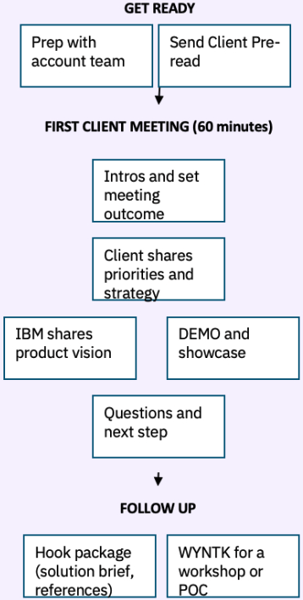
Know your buyer
IBM and Business Partner Internal Use Only
Any mid-size organization that has an interest in building, deploying & orchestrating personalized AI assistants & agents to automate work across the enterprise by integrating any AI model, data source &business application
Top Industries:
Professional Services 25%, Banking/Insurance 25%, Computer Services 25%, Retail 25%
Top Geographies:
Americas 50%, EMEA 30%, APAC 10%, Japan 10%
Technical environment:
Multiple disconnected tools, applications & data sources, looking to integrate apps & simplify access to information/data/tools
Multiple, complex systems with different UIs and multiple-step processes
Lack of visibility into business operations & need to make better data-based decisions
From the prospecting virtual academy →
Notes:
The worldwide sales team has prepared a watsonx Orchestrate virtual sales academy that every seller should review in Seismic at: https://ibm.seismic.com/Link/Content/DC493Mc9CRB8B8MVPRf4RQH7PTQj.
This slide shows an excerpt from one of the assets on the Seismic page, specifically a portion of the Know your buyer section. It is located in the Prospecting section of the academy at: https://ibm.seismic.com/Link/Content/DC493Mc9CRB8B8MVPRf4RQH7PTQj#/?anchorId=cd05791f-5f86-4edf-8e8a-09bb0a76f947.
Terminology:
APAC: Asia-Pacific
EMEA: Europe, Middle East and Africa
UI: User interface

Slide 68
Key questions
IBM and Business Partner Internal Use Only
How are you currently addressing labor shortages or skills gaps in your organization?
Are your employees facing difficulties managing or integrating multiple applications to access critical data and perform tasks effectively?
Do you implement generative AI, or traditional AI & machine learning use cases at your company today?
Do you have any concerns about deploying AI solutions? (trust, security)
How are you evaluating technologies that can streamline repetitive tasks and enhance end-to-end processes?
From the prospecting virtual academy →
Notes:
This slide shows the Key questions from the same asset discussed on the previous slide, available at: https://ibm.seismic.com/Link/Content/DC493Mc9CRB8B8MVPRf4RQH7PTQj#/?anchorId=cd05791f-5f86-4edf-8e8a-09bb0a76f947.
Sellers should review all virtual sales academy content at: htps://ibm.seismic.com/Link/Content/DC493Mc9CRB8B8MVPRf4RQH7PTQj.

Slide 69
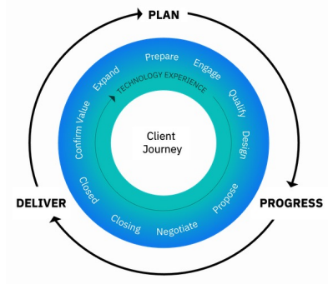
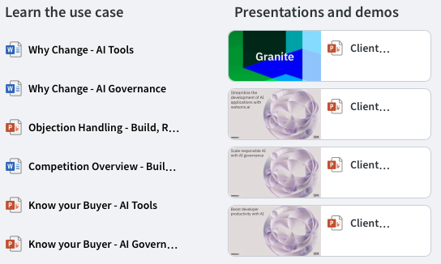
Accelerate the business impact of AI sales play
IBM and Business Partner Internal Use Only
Accelerate the Business Impact of AI sales play →
Slack: #ama-sales-play →
Notes:
In addition to the watsonx Orchestrate virtual sales academy discussed on the previous two slides, there is an Accelerate the business impact of AI sales play that every seller should review.
Each sales play contains assets to increase client product understanding, create demand, and gain buyer interest with a “Show Me, Don’t Tell Me” approach.
Links:
Accelerate the Business Impact of AI sales play: https://ibm.seismic.com/Link/Content/DChVJfBHdPqWR82BQ9mDWH4pgRBB
Sales plays on Slack: https://ibm-technology-sales.slack.com/archives/C03DVKJG2N9
All IBM sales plays: https://ibm.seismic.com/Link/Content/DCDcmQHfRHDQC8HC94PFjpGMChd8

Slide 70
watsonx Orchestrate: Classic & Agentic release guidance
IBM and Business Partner Internal Use Only
The watsonx Orchestrate Agentic update was announced on May 30, 2025.
New opportunities
Progressing opportunities
Recently closed opportunities
Position the new Agentic version of watsonx Orchestrate, relying on the new sales materials:
Seismic →
Winning Sales campaigns →
Introduce clients to the new agentic version.
For correct PoX solutioning, review the roadmap & transition guidance →
If a PoX is Skill Studio and Automation-centric, consider the agentic version. Only if there are blockers, proceed with the Classic version.
Evaluate the use case, timeline & requirements
If they are mostly agentic or assistant-centric, onboard client to the new Agentic version
If use case is Skill Studio and automation-centric, evaluate if the Tool flow builder can fulfill the use case requirement. If not, continue with Classic.
Notes:
The Agentic release of watsonx Orchestrate was officially announced on May 30, 2025, marking a major evolution in the platform. This release brings a shift toward a more dynamic, multi-agent approach, which changes how sellers should position, progress, and support opportunities.
There are three key sales guidance scenarios to consider, relative to the previous (or “Classic”) version:
For new opportunities, sellers should always position the Agentic version using the updated sales materials in Seismic (https://ibm.seismic.com/Link/Content/DCbHf2RCFTPf3G9Cc2PBGggJWfGV) and the Winning Sales Campaigns (https://ibm.seismic.com/Link/Content/DCgcJ73JD7GPT8c2MhjjhmCBJfRj#/?anchorId=984bb767-5672-4f3d-8735-72405095d4a9) to guide client conversations.
For progressing opportunities, sellers should introduce clients to the Agentic version early, using the roadmap and transition guidance (https://ibm.seismic.com/Link/Content/DCbHf2RCFTPf3G9Cc2PBGggJWfGV#/?anchorId=959ab4f8-4871-444c-abff-be004cbdf09a) to properly solution a PoX. If the proof of experience (PoX) is focused on Skill Studio and automation, sellers should check whether the Agentic version meets the requirements, and only use Classic if blockers exist.
For recently closed opportunities, sellers should reevaluate based on use case, timeline, and requirements:
If the focus is more agentic or assistant-centric, sellers should onboard the client to the Agentic version.
If it’s heavily Skill Studio and automation-centric, sellers should assess whether the new Tool Flow Builder in Agentic can meet the needs. If not, they should procede with the Classic version.
The goal is to help clients transition to the modern platform when appropriate, while being mindful of technical fit and delivery timelines.
Terminology:
PoX: Proof of Experience

Slide 71
What about watsonx Assistant clients?
IBM and Business Partner Internal Use Only
New opportunities
Existing watsonx Assistant clients should understand the value of watsonx Orchestrate
watsonx Assistant
watsonx Orchestrate is the “lead-with”product
AI agents & assistants will be top of mind in many conversation with clients
Know your buyer & look for use cases for a PoX
There are multiple paths to migrate watsonx Assistant customers to watsonx Orchestrate while modernizing & expanding
On-prem has trade up and perpetual parts available to ease the pricing transition
Existing clients
Migration
Clients lift & shift their AI assistants built “as is” into watsonx Orchestrate
--- OR ---
Modernization
Clients modernize their AI assistant from a deterministic, fixed flow paradigm into an AI agent with watsonx Orchestrate
Moving clients to watsonx Orchestrate →
Notes:
IBM has a strong footprint with thousands of clients using watsonx Assistant, making this a strategic base to build from.
For all new AI assistant opportunities, sellers should always position watsonx Orchestrate, including customer care use cases.
For existing watsonx Assistant clients, watsonx Orchestrate offers feature and platform parity in many areas, and significantly expands capabilities in areas like agent orchestration, collaboration, and generative AI.
There are multiple paths for migration, including options that preserve cost neutrality through trade-up and perpetual part pricing, especially for on-prem clients. The migration experience continues to improve: clients can already reuse Actions and Steps, and even legacy Dialog conversation flows.
Existing watsonx Assistant clients can choose one of two paths:
1. Migration: a “lift and shift” of existing assistants into the watsonx Orchestrate platform.
2. Modernization: transforming fixed-flow assistants into dynamic AI agents with knowledge, tools, and greater flexibility.
This is a key moment to help clients move from deterministic flows to adaptive AI agents, with watsonx Orchestrate as the upgrade path.
More information on moving watsonx Assistant clients to watsonx Orchestrate can be found at https://ibm.seismic.com/Link/Content/DCbHf2RCFTPf3G9Cc2PBGggJWfGV#/?anchorId=2268f988-f81c-4f1e-8263-7301e352382f.
Terminology:
PoX: Proof of Experience

Slide 72
watsonx Orchestrate competitive differentiation
Competitive deck in Seismic →
Notes:
In the competitive landscape of conversational AI, business automation, and the AI agent marketplace, understanding the strengths and weaknesses of key competitors is vital. Understanding these aspects also reveals how IBM's offering stands out, showcasing a clear and compelling value proposition that resonates with businesses seeking innovative solutions. This section outlines these competitors and contrasts IBM’s value.
This section’s content is partially a subset of the watsonx Orchestrate competitive deck, available at: https://ibm.seismic.com/Link/Content/DCTCd3FPgCpb4G2Bc6q27WWP2BdG

Slide 73

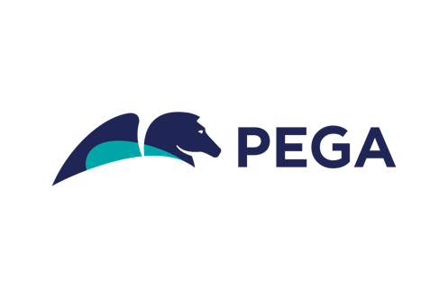

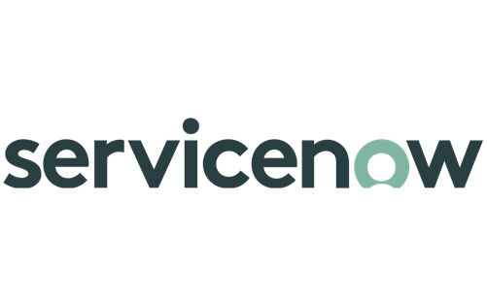

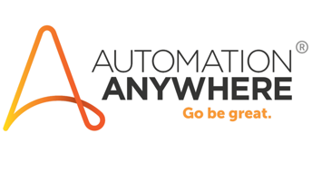

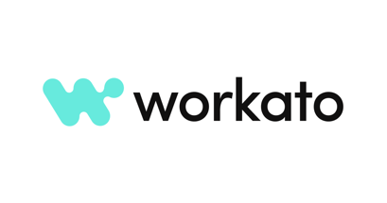








Four types of vendors in this space to be aware of
IBM and Business Partner Internal Use Only
Conversational AI vendors
Historically focused on Customer Care, less so on enterprise productivity. Limited automation capabilities but strong connectivity to open source and 3rd party LLMs (with strong focus on Open AI models).
Automation vendors
Traditional RPA and task automation providers, expanding into the CAI and Gen AI space rapidly through partnerships. Infusing AI across the automation stack as well as the experience layer.
Traditional hyperscalers
Cloud computing companies with end-to-end Gen AI and CAI platform, tightly coupling it with their various productivity, knowledge and automation products.
Incumbent domain ISVs
Software companies with specialized domain platforms rapidly infusing Generative AI and Agentic capabilities across their platforms. Strong focus on
Co-pilot Studio
Competitive deck in Seismic →
Notes:
IBM, as well as external analysts¹, have observed various markets converging towards building AI automation platforms to digitize labor, including the categories of vendors shown on this slide.
For example:
Robotic Process Automation (RPA) vendors are adding Intelligent Document Processing (IDP), process and task mining, API connectors, and digital assistants.
Conversational Artificial Intelligence (CAI) vendors are adding API connectors, RPA and document ingestion to enable digital assistants to automate work.
This self-explanatory slide expands upon the four different types of vendors that sellers should be aware of.
This content is a subset of the watsonx Orchestrate competitive deck, available at: https://ibm.seismic.com/Link/Content/DCTCd3FPgCpb4G2Bc6q27WWP2BdG
Source:
¹ “AI Agents Market worth $47.1 billion by 2030”, PR Newswire (summary of the for-fee report), September 2024: https://www.prnewswire.com/news-releases/ai-agents-market-worth-47-1-billion-by-2030---exclusive-report-by-marketsandmarkets-302246356.html

Slide 74



IBM’s enduring advantage
Fast time-to-value with pre-built AI agents & tools for proven high-ROI use cases
Orchestrate AI agents and automations across the enterprise to deliver a unified experience
Open - seamlessly integrates across apps, automations, clouds, & vendors
Build for the future with no-code to pro-code options for business & technical users
Trustworthy LLMs with enterprise governance reduce risks of going live while optimizing for performance
Enterprise-ready - deploy natively across clouds of your choice or on-prem
Notes:
This slide captures the core reasons why IBM watsonx Orchestrate stands out in a crowded and fast-evolving AI market.
Fast time-to-value. IBM watsonx Orchestrate delivers impact from day one with pre-built AI agents and tools. These are targeted at high-ROI use cases in domains such as HR, sales, and procurement, helping clients avoid the complexity of starting from scratch and realize value quickly.
Enterprise-wide orchestration. Unlike point solutions, watsonx Orchestrate is designed to unify experiences across the enterprise. It coordinates agents and tools across departments, platforms, and channels, giving users a seamless way to get work done, regardless of backend complexity.
Open and extensible. IBM watsonx Orchestrate is built to integrate, not replace. It works across clouds, existing applications, third-party tools, and even competitor agents. This open architecture lowers adoption barriers and protects prior investments.
Flexible for all users. Whether it’s business users leveraging the no-code Agent Builder or developers working in pro-code Agent Development Kit (ADK), watsonx Orchestrate supports the full spectrum of users building AI agents.
Trustworthy & performant by design. IBM delivers enterprise-grade governance, transparency, and oversight to help organizations confidently deploy generative AI. With built-in observability and large language model (LLM) supervision, IBM reduces hallucination risk while ensuring consistent, trusted performance. IBM sets the industry standard for LLM transparency¹, enabling users to understand how decisions are made—critical for building trust and ensuring accountability. Forrester has recognized IBM’s LLMs for their strong security posture, including encryption, access controls, and secure data handling practices that protect sensitive information.² IBM’s LLMs also push the boundaries of language generation and understanding, consistently outperforming much larger models. ³ In speech AI, IBM’s latest large speech model (LSM) surpasses leading alternatives such as OpenAI’s Whisper, delivering lower word error rates and faster processing times. ⁴
Truly enterprise-ready. IBM watsonx Orchestrate supports flexible deployment, whether on IBM Cloud, other public clouds, or on-premise. This level of enterprise readiness ensures that organizations maintain control over data, compliance, and infrastructure.
Together, these six differentiators position IBM watsonx Orchestrate as a uniquely capable and credible solution for enterprises serious about scaling AI with confidence.
Sources:
¹ “IBM Granite transparency”, IBM Research, May 2024: https://research.ibm.com/blog/ibm-granite-transparency-fmti
² “IBM Granite models named a strong performer in The Forrester Wave”, IBM, June 2024: https://www.ibm.com/blog/announcement/granite-models-forrester-wave-strong-performer
³ “IBM Granite outperforms other open-source models”, The Decoder, May 2024: https://the-decoder.com/ibms-granite-code-outperforms-all-other-open-source-code-models
⁴ “IBM’s large speech model brings generative AI to the phone”, IBM, January 2024: https://www.ibm.com/blog/ibms-new-watson-large-speech-model-brings-generative-ai-to-the-phone

Slide 75
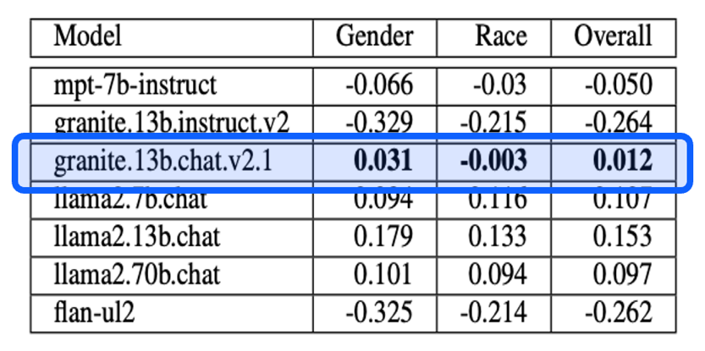

Why IBM?
Leading Technology
Expertise
Trusted AI
IBM has the experience, technology & experts
to help you on your generative & agentic AI journey
10+ years
5+ years
recognized by analysts & third-party benchmarks as market leader
Industry’s most trusted LLM for enterprise usage
Consistently less biased
Scores high on harmlessness across attack domains
Outperforms significantly larger LLMs across domains & languages
of experience in AI assistants & agents
1 billion
50K+
and growing, skilled data & AI practitioners
AI assistant messages processed each month
10K
2K+
AI use cases developed for clients in 2024
clients using IBM watsonx AI assistant technology
Notes:
IBM understands the AI agent technology and its potential well and has a significant presence in this market, including the experience to deliver on these expectations with industry-leading AI. IBM has been serving some of the world's largest and most complex organizations for over a decade, with its AI assistants and agents processing over a billion messages monthly.
Today, well over 10,000 clients are using IBM’s AI assistants and agents, with some having up to 10 million monthly active users (MAUs). IBM can index billions of documents and help businesses execute trillions of decisions using its rules and automation engines.
With over 50,000 data and AI practitioners and over 15,000 strategy and design consultants, IBM also has the expertise and skills to help clients take an experience-led approach that maximizes end-user adoption. The IBM team deploys thousands of AI use cases in production every year and has delivered over 40,000 AI and analytics client engagements.¹
Finally, IBM's models are trusted, lead the industry in their transparency, and the company stands behind each one. This is important because companies are increasingly cautious about putting large language models (LLMs) in front of their customers. IBM designs LLMs specifically for enterprise use, built around three key tenets: trust, speed, and cost-effectiveness. IBM’s models are the most reliable and trusted LLMs for enterprise usage, with less bias and high scores on harmlessness across attack domains. IBM’s LLMs also outperform much larger models, meaning they can be orders of magnitude less costly to run than other models.^{2,3}
[Note to sellers on the “Trusted AI” point:
IBM Granite is trusted. This has two facets, the first of which is transparency: Clients should know what is in the large language model (LLM). IBM publishes a white paper identifying all data sources included in the LLM – no other vendor does this.
IBM has confidence in Granite’s data. This is important as an increasing number of people and companies that create content are suing LLM companies because their copyright or intellectual property is violated. LLMs are still new, and it's not yet clear what liability is faced by a user (whether an individual or a company) who didn't create the model. IBM indemnifies its clients, meaning that if they get sued based on copyright information within IBM’s models, IBM will protect them. This is a testament to the transparency and quality of IBM model data.
The second facet of Granite’s trustworthiness is the performance test results compared to other models. Using industry-standard bias and harmlessness benchmarks, IBM models are compared to models including ChatGPT, Llama, and others. The first benchmark is the Bias and Open-ended Language generation Data set (BOLD), the results of which are shown in the table on the slide, with additional information available in the linked benchmark report. The metric scores an input text (such as a sentence) as having a positive, neutral, or negative regard, with the perfect score being 0. Positive and negative scores suggest that the model is more inclined to produce biased text than an original associated sentence in Wikipedia, which is considered the “ground-truth.”
The second test is AttaQ, which includes an IBM-curated dataset consisting of Question/Attack samples and aims to elicit responses from the model around deception, discrimination, harmful information, substance abuse, explicit content, personally identifiable information, and violence. This benchmark test automatically evaluates the input-output pairs using a preference model. As the bar chart on the slide shows, the Granite-13b model has the highest number of acceptable answers.] Sources:
¹ “IBM Consulting Expands Capabilities to Help Enterprises Scale AI,” IBM, May 2024, https://newsroom.ibm.com/Blog-IBM-Consulting-Expands-Capabilities-to-Help-Enterprises-Scale-AI
² Granite benchmark report, IBM, May 2024: https://www.ibm.com/downloads/cas/X9W4O6BM
³ Granite performance benchmarks, IBM, May 2025 (IBMers only), https://ibm.ent.box.com/s/57brfucf0t1yuhfwhaucnodne32wxhgd and https://lake-llm.cash.sl.cloud9.ibm.com/superset/dashboard/27/

Slide 76
watsonx Orchestrate packaging & pricing basics
Note: watsonx Orchestrate pricing is evolving based on fast-changing AI agent market trends. Always check the latest pricing and packaging deck.
Pricing and packaging deck →
Pricing on ibm.com →
Notes:
This section helps sellers move opportunities toward closure by assisting them in understanding the fundamentals of pricing.
This content is a subset of the watsonx Orchestrate pricing and packaging deck, available at: https://ibm.seismic.com/Link/Content/DC4c3hHGgjgGpGTW9VDCjc3344CG. Additional pricing information is also available on ibm.com at: https://www.ibm.com/products/watsonx-orchestrate/pricing.
Sellers should note that watsonx Orchestrate pricing is evolving based on fast-changing AI agent market trends and should always check the latest pricing and packaging deck.

Slide 77
New Agentic Plan Pricing (Effective May 2025)
IBM launched Agentic Plan Instances in May 2025
New primary go-to-market pricing model for all use cases
Simplified billing metric: Monthly Active Users (MAUs) –unique users accessing the cloud service in any way (chat, voice, workflow)
Each MAU includes up to 50 messages/month; above that, the user is counted as an additional MAU
High-frequency users (Call Center, SMEs) can be estimated at up to 100 MAUs
15 IDP pages = 1 MAU equivalent
Pricing and packaging deck →
Notes:
IBM introduced a simplified and scalable pricing model in May 2025 with the launch of Agentic Plan Instances. This plan uses a Monthly Active User, or MAU, as the primary billing metric. A MAU represents any unique person who interacts with the cloud service. This includes initiating a chat, calling an agent, or triggering a workflow. Each MAU includes 50 messages; if usage exceeds that, they are counted as multiple MAUs. For high-volume users, such as contact center agents, sellers should estimate conservatively at around 100 MAUs. Importantly, 15 document pages processed also count as 1 MAU. This approach makes pricing predictable and aligns cost with usage.
This content is a subset of the watsonx Orchestrate pricing and packaging deck, available at: https://ibm.seismic.com/Link/Content/DC4c3hHGgjgGpGTW9VDCjc3344CG.
Terminology:
IDP: Intelligent document processing
SMEs: Subject matter experts

Slide 78
Message Definition & IBM Pre-built Agent Pricing
Message – any query sent to an AI agent or assistant that results in a processed action or response,
Messages include chat messages, triggered workflows & document page processing
Prebuilt domain agents are priced at $100/month
Pricing and packaging deck →
Notes:
The pricing model also defines what constitutes a "message" — this includes questions asked in an agentic chat, a workflow execution, or even document processing. Each of these interactions consumes messages under a user's monthly allotment. Additionally, IBM has introduced prebuilt AI agents for high-ROI domains. For instance, IBM offers Employee Support agents designed for Workday and Oracle HCM systems. Each of these prebuilt agents is priced at $100 per month and IBM plans to expand this catalog to other business domains including Procurement and Sales.
This content is a subset of the watsonx Orchestrate pricing and packaging deck, available at:
https://ibm.seismic.com/Link/Content/DC4c3hHGgjgGpGTW9VDCjc3344CG.
Terminology:
Subscription RUs: Resource Units allocated under the subscription model pricing. These units serve as a standardized metric to quantify and manage the usage of watsonx Orchestrate.

Slide 79
Transition Guidance – Classic vs Agentic Plans
Classic Plan instances remain available by special request only and include classic metering: MAUs, Skill Runs, Tokens, Decisions, IDP pages
Classic Plan should only be sold if necessary due to client use case blockers
Existing Classic clients continue under legacy pricing
All new opportunities should default to Agentic Plans
Pricing and packaging deck →
Notes:
While the new Agentic Plan Instances are the default and recommended pricing model, Classic Plan Instances are still available by exception. These older plans rely on more complex charge metrics including Skill Runs and Token usage. They should only be considered when absolutely required due to client-specific constraints or legacy integrations. Existing Classic Plan clients will continue on the older model unless migrated. For all new deals and pricing estimates, sellers should prioritize the Agentic Plan for its clarity, scalability, and simplicity.
This content is a subset of the watsonx Orchestrate pricing and packaging deck, available at:
https://ibm.seismic.com/Link/Content/DC4c3hHGgjgGpGTW9VDCjc3344CG.

Slide 80
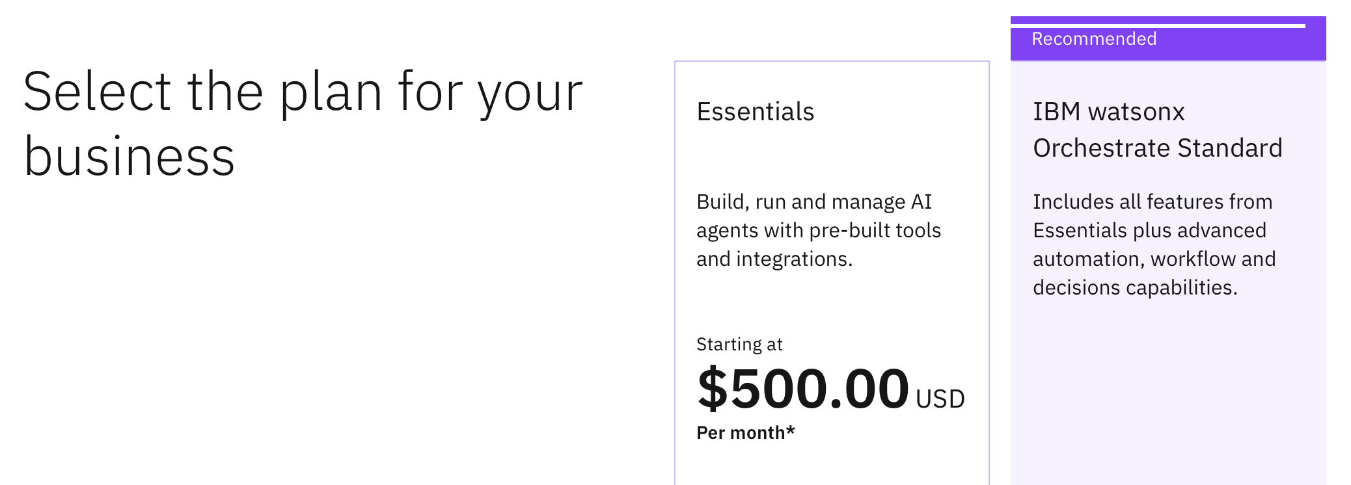
Sizing and pricing an opportunity
Define the use case
Select the right plan
Estimate usage
Include pre-built agents
Use the pricing calculator for accurate quoting and configuration
Pricing and packaging deck →
Notes:
This slide explains how to scope and size a watsonx Orchestrate deployment for accurate pricing and plan selection.
Sellers should begin by defining the use case, for example, a self-serve “Ask HR” assistant for employees, a customer care assistant for external users, or a digital assistant embedded on a product page.
Once the use case is clear, sellers should choose the right plan:
Premium is required if data isolation is needed—this supports handling of personal or sensitive information (PI/SPI).
Standard is ideal for most enterprise clients who do not need data isolation. It allows for up to 30 agents and supports many advanced features, some of which will only be available in the Standard and Premium tiers going forward.
Essentials is best suited for small-scale or trial deployments. However, it’s important to note that future enterprise features will not be included here, so default to Standard whenever possible.
Next, sellers should size the deployment by estimating the number of Monthly Active Users (MAUs), users who send 50 or fewer messages per month.
For power users, such as call center agents or HR SMEs who interact frequently, sellers should estimate each one as equivalent to 100 MAUs, since they may use up to 5,000 messages monthly.
Sellers also need to consider the volume of intelligent document processing (IDP), which is billed per page processed.
If the solution includes IBM pre-built agents, sellers should remember to include an additional $100/month per pre-built agent in the quote.
Finally, sellers should use the pricing calculator and quoting guide to accurately estimate total costs.
The sizing calculator can be found at: https://ibm.seismic.com/Link/Content/DCGCRhTJRg9pWGMFgW33pqDJbF9P.

Slide 81
Next steps for sellers
Take the IBM Client Zero enablement
Complete the product virtual academy
Explore the product page
Practice the pitch & demo
Practice your stand & deliver for Client Zero stories
Link → (IBMers)
Link → (BPs)
Duration: 60 minutes
Learn best practices to identify buyers & how to position
Link →
Duration: 45 minutes
Know where to find the latest materials to engage, size & price your client opportunities
Link →
Duration: 10 minutes
Learn & use the new demo in your next client briefing
Link → (Client Zero, IBMers only)
Link → (Level 3 course)
Duration: 30 minutes (Client Zero demo) to 4 hours (Level 3 course)
Notes:
This slide outlines actionable next steps for sellers to drive success with watsonx Orchestrate:
Start with the IBM Client Zero enablement. This is IBM’s most powerful proof point—learn it well, and practice delivering the story with confidence. It’s designed to resonate with real client pain points and show how IBM is solving them internally. Link for IBMers: https://w3.ibm.com/w3publisher/transformation-operations/client-zero. Link for BPs: https://ibm.seismic.com/Link/Content/DC3FBFRjP8VpR8QPRHF9Xh7VfDdj.
Complete the product virtual academy. This will deepen seller understanding of how to identify the right buyer personas and tailor the approach. Sellers will gain insight into how to lead conversations that connect the client’s business goals to agentic outcomes. Link: https://ibm.seismic.com/Link/Content/DC493Mc9CRB8B8MVPRf4RQH7PTQj.
Bookmark and explore the product page. This is your hub for staying current. You’ll find updated assets, sizing guidance, pricing information, and pitch materials—everything needed to prepare for client engagement. Link: https://ibm.seismic.com/Link/Content/DCbHf2RCFTPf3G9Cc2PBGggJWfGV.
Finally, practice the pitch and demo. The new demo is designed for impact. Sellers should get comfortable with it and use it in their next client briefing to bring the product to life. Link to Client Zero demo: https://ibm.biz/wx-cz-demo. Link to Level 3 course: https://yourlearning.ibm.com/activity/PLAN-B4BFAE1FED99.
Together, these steps will help every seller position watsonx Orchestrate with confidence, relevance, and clarity.

Slide 82
Notes:
This is the closing slide, which requires no speaker notes.

